Slide 1
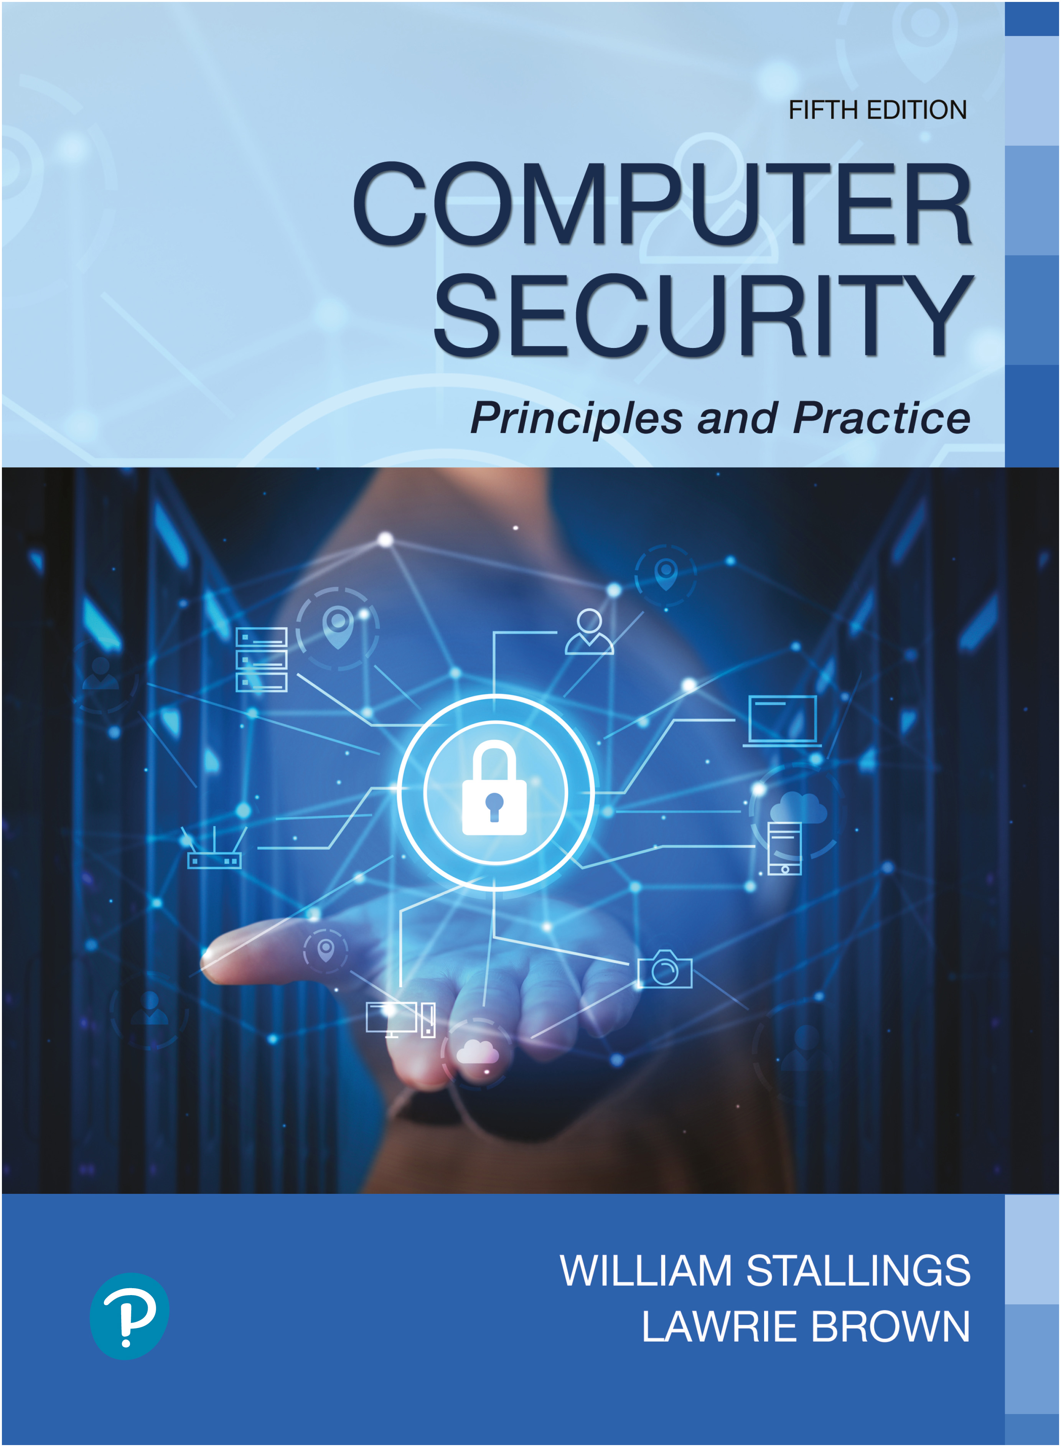

Computer Security: Principles and Practice
Fifth Edition
Chapter 12
Operating System Security
Copyright © 2024, 2018, 2015 Pearson Education, Inc. All Rights Reserved
Notes:
If this PowerPoint presentation contains mathematical equations, you may need to check that your computer has the following installed:
1) MathType Plugin
2) Math Player (free versions available)
3) NVDA Reader (free versions available)
Computer client and server systems are central components of the IT infrastructure for most organizations. The client systems provide access to organizational data and applications supported by the servers housing those data and applications. However, given that most large software systems will almost certainly have a number of security weaknesses, as we discussed in Chapter 6 and in the previous two chapters, it is currently necessary to manage the installation and continuing operation of these systems to provide appropriate levels of security despite the expected presence of these vulnerabilities In some circumstances, we may be able to use trusted computing systems designed and evaluated to provide security by design.
In this chapter, we discuss how to provide systems security as a hardening process that includes planning, installation, configuration, update, and maintenance of the operating system and the key applications in use, following the general approach detailed in NIST SP 800-123 (Guide to General Server Security, July 2008). We con-
sider this process for the operating system, then consider key applications in general, and then discuss some specific aspects in relation to Linux and Windows systems in particular. We continue with a discussion on securing virtualized systems, in which multiple virtual machines may execute on the one physical system. Finally we conclude with an introduction to trusted computer systems and the trusted platform module.

Slide 2
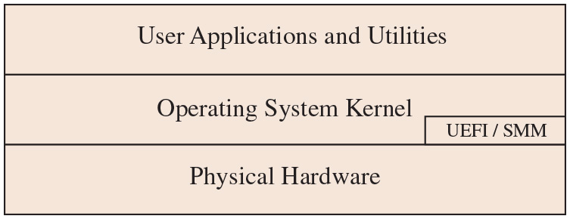
Figure 12.1
Operating System Security Layers
NSA uses BIOS and SMM to place persistent backdoors in firewalls and routers
Each layer is vulnerable to attack from below (since it makes calls to the lower layer for services)
For background on BIOS, see
http://csrc.nist.gov/publications/nistpubs/800-147/NIST-SP800-147-April2011.pdf
SJW
Notes:
We can view a system as having a number of layers, with the physical hardware at the bottom; the base operating system above, including privileged kernel code, A P I s, and services; and finally user applications and utilities in the top layer, as shown in Figure 12.1. This figure also shows the presence of U E F I (or B I O S) and
possibly other code that is external to, and largely not visible from, the operating system kernel but is used when booting the system or to support low-level hardware control. Each of these layers of code needs appropriate hardening measures in place to provide appropriate security services. And each layer is vulnerable to attack from below, should the lower layers not also be secured appropriately.

Slide 3
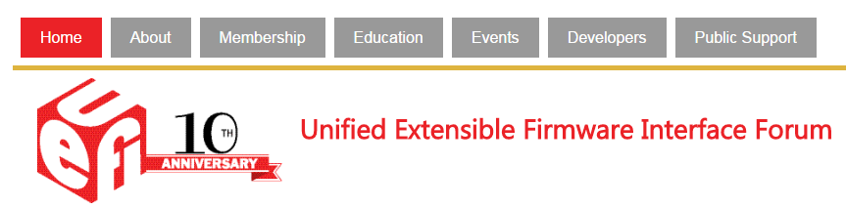
UEFI
SJW

Slide 4
Strategies (1 of 2)
The 2010 Australian Signals Directorate (A S D) lists the “Strategies to Mitigate Cyber Security Incidents”
At least 85% of the targeted cyber intrusions investigated by A S D would have been prevented
The four strategies for prevention are:
Allow-list approved applications
Patch third-party applications and operating system vulnerabilities
Restrict administrative privileges
Notes:
A number of reports note that the use of a small number of basic hardening measures can prevent a large proportion of the attacks seen in recent years. Since
2010, the Australian Signals Directorate (A S D) list of the “Strategies to Mitigate Cyber Security Incidents” [A C S C 17] notes that implementing just four of these strategies would have prevented at least 85% of the targeted cyber intrusions investigated by A S D. The four strategies are:
1. Allow-list approved applications
2. Patch third-party applications
3. Patch operating system vulnerabilities and use the latest versions
4. Restrict administrative privileges

Slide 5
Strategies (2 of 2)
In 2017, the updated list “Essential Eight” was published
It adds the following items:
Configure Microsoft Office macro settings
User application hardening
Multifactor authentication
Regular backups
Collectively these assist in creating a defense-in-depth system
Essential Eight Maturity Model
These strategies largely align with those in the “20 Critical Controls” developed by DHS, NSA, the Department of Energy, SANS, and others in the United States
Look this list over
SJW
Notes:
More recently, in 2017 they updated this list and also published the “Essential Eight,” designed to protect Microsoft Windows-based Internet-connected systems. It adds the following items:
5. Configure Microsoft Office macro settings
6. User application hardening
7. Multifactor authentication
8. Regular backups
Collectively these assist in creating a defense-in-depth system. We discuss these strategies, and many others in the A S D list, in this chapter. Note that these strategies
largely align with those in lists of “Critical Security Controls” developed by D H S, N S A, the Department of Energy, S A N S, and others in the United States.

Slide 6
Operating System Security
Possible for a system to be compromised during the installation process before it can install the latest patches
Building and deploying a system should be a planned process designed to counter this threat
Process must:
Assess risks and plan the system deployment
Secure the underlying operating system and then the key applications
Ensure any critical content is secured
Ensure appropriate network protection mechanisms are used
Ensure appropriate processes are used to maintain security
Notes:
As we noted above, computer client and server systems are central components of the I T infrastructure for most organizations, may hold critical data and applications, and are a necessary tool for the function of an organization. Accordingly, we need to be aware of the expected presence of vulnerabilities in operating systems and applications as distributed and the existence of worms scanning for such vulnerabilities at high rates, such as we discussed in Section 6.3. Thus, it is quite possible for a system to be compromised during the installation process before it can install the latest patches or implement other hardening measures. Hence building and deploying a system should be a planned process designed to counter such a threat and to maintain security during its operational lifetime.
N I S T S P 800-123 states that this process must:
• Assess risks and plan the system deployment
• Secure the underlying operating system and then the key applications
• Ensure any critical content is secured
• Ensure appropriate network protection mechanisms are used
• Ensure appropriate processes are used to maintain security
We addressed the selection of network protection mechanisms in Chapter 9, and we will examine the other items in the rest of this chapter.

Slide 7

System Security Planning
The first step in deploying a new system is planning
Plan needs to identify appropriate personnel and training to install and manage the system
Planning should include a wide security assessment of the organization
Planning process needs to determine security requirements for the system, applications, data, and users
Aim is to maximize security while minimizing costs
Notes:
The first step in deploying new systems is planning. Careful planning will help ensure that the new system is as secure as possible and complies with any necessary policies. This planning should be informed by a wider security assessment of the organization, since every organization has distinct security requirements and concerns. We discuss this wider planning process in Chapters 14 and 15.
The aim of the specific system installation planning process is to maximize security while minimizing costs. Wide experience shows that it is much more difficult and expensive to “retro-fit” security at a later time than it is to plan and provide it during the initial deployment process. This planning process needs to determine the security requirements for the system, its applications and data, and its users. This then guides the selection of appropriate software for the operating system and applications and provides guidance on appropriate user configuration and access control settings. It also guides the selection of other hardening measures required. The plan also needs to identify appropriate personnel to install and manage the system, noting the skills required and any training needed.

Slide 8
System Security Planning Process
The purpose of the system, the type of information stored, the applications and services provided, and their security requirements
The categories of users of the system, the privileges they have, and the types of information they can access
How the users are authenticated
How access to the information stored on the system is managed
What access the system has to information stored on other hosts, such as file or database servers, and how this is managed
Who will administer the system and how they will manage the system (via local or remote access)
Any additional security measures required on the system, including the use of host firewalls, anti-virus or other malware protection mechanisms, and logging
Notes:
N I S T S P 800-123 provides a list of items that should be considered during the system security planning process. While its focus is on secure server deployment, much of the list applies equally well to client system design. This list includes consideration of:
• The purpose of the system, the type of information stored, the applications and services provided, and their security requirements
• The categories of users of the system, the privileges they have, and the types of information they can access
• How the users are authenticated
• How access to the information stored on the system is managed
• What access the system has to information stored on other hosts, such as file or database servers, and how this is managed
• Who will administer the system, and how they will manage the system (via local or remote access)
• Any additional security measures required on the system, including the use of host firewalls, anti-virus or other malware protection mechanisms, and logging

Slide 9
Operating Systems Hardening
First critical step in securing a system is to secure the base operating system
Basic steps
Install and patch the operating system
Harden and configure the operating system to adequately address the identified security needs of the system by:
Removing unnecessary services, applications, and protocols
Configuring users, groups, and permissions
Configuring resource controls
Install and configure additional security controls, such as anti-virus, host-based firewalls, and intrusion detection system (I D S)
Test the security of the basic operating system to ensure that the steps taken adequately address its security needs
Notes:
The first critical step in securing a system is to secure the base operating system upon which all other applications and services rely. A good security foundation needs a properly installed, patched, and configured operating system. Unfortunately, the default configuration for many operating systems often maximizes ease of use and functionality, rather than security. Further, since every organization has its own security needs, the appropriate security profiles, and hence configurations, will also differ. What is required for a particular system should be identified during the planning phase, as we have just discussed.
While the details of how to secure each specific operating system differ, the broad approach is similar. Appropriate security configuration guides and checklists exist for most common operating systems, and these should be consulted, though always informed by the specific needs of each organization and its systems. In some cases, automated tools may be available to further assist in securing the system configuration.
N I S T S P 800-123 suggests the following basic steps should be used to secure an operating system:
• Install and patch the operating system
• Harden and configure the operating system to adequately address the identified security needs of the system by:
• Removing unnecessary services, applications, and protocols
• Configuring users, groups, and permissions
• Configuring resource controls
• Install and configure additional security controls, such as anti-virus, host-based firewalls, and intrusion detection systems (IDS), if needed
• Test the security of the basic operating system to ensure that the steps taken adequately address its security needs

Slide 10
Initial Setup and Patching
System security begins with the installation of the operating system
Ideally, new systems should be constructed on a protected network
Full installation and hardening process should occur before the system is deployed to its intended location
Initial installation should install the minimum necessary for the desired system
Overall boot process must also be secured
The integrity and source of any additional device driver code must be carefully validated
Critical that a system be kept up to date, with all critical security related patches installed
Should stage and validate all patches on test systems before deploying them in production
Notes:
System security begins with the installation of the operating system. As we have already noted, a network-connected, unpatched system is vulnerable to exploit during its installation or continued use. Hence it is important that the system not be exposed while in this vulnerable state. Ideally, new systems should be constructed on a protected network. This may be a completely isolated network, with the operating system image and all available patches transferred to it using removable media such as D V D s or U S B drives. Given the existence of malware that can propagate using removable media, as we discuss in Chapter 6, care is needed to ensure the media used here is not infected. Alternatively, a network with severely restricted access to the wider Internet may be used. Ideally, it should have no inbound access and have outbound access only to the key sites needed for the system installation and patching process. In either case, the full installation and hardening process should occur before the system is deployed to its intended, more accessible, and hence vulnerable, location.
The initial installation should install the minimum necessary for the desired system, with additional software packages included only if they are required for the function of the system. We explore the rationale for minimizing the number of packages on the system shortly.
The overall boot process must also be secured. This may require adjusting options on, or specifying a password required for changes to, the UEFI (or B I O S) code used when the system initially boots. It may also require limiting which media the system is normally permitted to boot from. This is necessary to prevent an attacker from changing the boot process to install a covert hypervisor, such as we discussed in Section 6.8, or to just boot a system of their choice from external media in order to bypass the normal system access controls on locally stored data. The use of a cryptographic file system may also be used to address this threat, as we note later.
Care is also required with the selection and installation of any additional device driver code, since this executes with full kernel level privileges but is often supplied by a third party. The integrity and source of such driver code must be carefully validated given the high level of trust it has. A malicious driver can potentially bypass many security controls to install malware. This was done in both the Blue Pill demonstration rootkit, which we discussed in Section 6.9, and the Stuxnet worm, which we described in Section 6.4.
Given the continuing discovery of software and other vulnerabilities for commonly used operating systems and applications, it is critical that a system be kept as up to date as possible, with all critical security related patches installed. Indeed, doing this addresses one of the four key A S D mitigation strategies we listed previously. Nearly all commonly used systems now provide utilities that can automatically download and install security updates. These tools should be configured and used to minimize the length of time any system is vulnerable to weaknesses for which patches are available.
On change-controlled systems, there can be a perception that running automatic updates may be detrimental, as they may on rare but significant occasions introduce instability. However, A S D notes that the delay in testing patches can leave systems vulnerable to compromise and that it believes that automatic update is preferable. For systems on which availability and uptime are of paramount importance, you may need to stage and validate all patches on test systems before deploying them in production. However, this process should be as timely as possible.

Slide 11
Patch Management
Patch management critical to reducing vulnerability
Estimated that 95% of security breaches could be prevented by keeping systems properly patched*
Need to be aware of vulnerability reports and issuance of patches
Assessing Security Vulnerabilities and Applying Patches | Cyber.gov.au
See The Critical Elements of the Patch Management Process
Cavusoglu, H., Cavusoglu, H. and Zhang, J. Security patch management - Share the burden or share the damage. Management Science (April 2008)
SJW

Slide 12
Patch Management
Critical elements of the patch management process*:
Senior executive support
Dedicated resources and clearly defined responsibilities
Creating and maintaining a current technology inventory
Identification of vulnerabilities and patches
One report detailed 7,329 “potential vulnerabilities” because software patches had not been installed.
SJW

Slide 13
Patch Management
Critical elements of the patch management process:
Scanning and monitoring the network for machines and patch levels
Pre-deployment testing of patches
Post-deployment scanning and monitoring of patch levels
Some patch sources:
http://www.microsoft.com/technet/security/current.aspx
http://www.us-cert.gov/reading_room/ See monthly and quarterly reports
http://www.us-cert.gov/cas/techalerts/
SJW

Slide 14
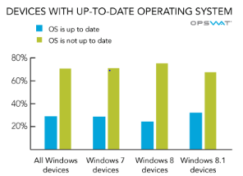
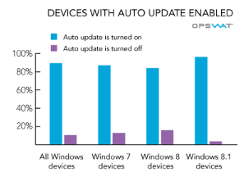
Patch Timeliness
Source: OPSWAT Antivirus and Operating System Report: October 2014

Slide 15
Remove Unnecessary Services, Applications, and Protocols
If fewer software packages are available to run, the risk (attack surface) is reduced
System planning process should identify what is actually required for a given system
When performing the initial installation, the supplied defaults should not be used
Default configuration is set to maximize ease of use and functionality rather than security
If additional packages are needed later they can be installed when they are required
Site creates an “image” of a properly configured system which is cloned for all new machine instances
SJW
Notes:
Because any of the software packages running on a system may contain software vulnerabilities, if fewer software packages are available to run, then the risk is reduced. There is clearly a balance between usability—providing all software that may be required at some time—with security and a desire to limit the amount of software installed. The range of services, applications, and protocols required will vary widely between organizations and indeed between systems within an organization. The system planning process should identify what is actually required for a given system so that a suitable level of functionality is provided, while eliminating software that is not required to improve security.
The default configuration for most distributed systems is set to maximize ease of use and functionality, rather than security. When performing the initial installation, the supplied defaults should not be used, but rather the installation should be customized so that only the required packages are installed. If additional packages are needed later, they can be installed when they required. N I S T S P 800-123 and many of the security hardening guides provide lists of services, applications, and protocols that should not be installed if not required.
N I S T S P 800-123 also states a strong preference for not installing unwanted software, rather than installing and then later removing or disabling it. It argues this
preference because it notes that many uninstall scripts fail to completely remove all components of a package. It also notes that disabling a service means that while it is not available as an initial point of attack, should an attacker succeed in gaining some access to a system, then disabled software could be re-enabled and used to further compromise a system. It is better for security if unwanted software is not installed and is thus not available for use at all.

Slide 16
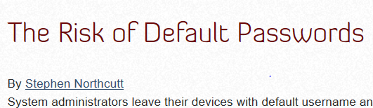
Configure Users, Groups, and Authentication
Not all users with access to a system will have the same access to all data and resources on that system
Elevated privileges should be restricted to only those users who require them, and then only when they are needed to perform a task
System planning process should consider:
Categories of users on the system
Privileges they have
Types of information they can access
How and where they are defined and authenticated
Default accounts included as part of the system installation should be secured
Those which are not required should be either removed or disabled
Policies that apply to authentication credentials configured
SJW
Notes:
Not all users with access to a system will have the same access to all data and resources on that system. All modern operating systems implement access controls to data and resources, as we discuss in Chapter 4 . Nearly all provide some form of discretionary access controls. Some systems may provide role-based or mandatory access control mechanisms as well.
The system planning process should consider the categories of users on the system, the privileges they have, the types of information they can access, and how and where they are defined and authenticated. Some users will have elevated privileges to administer the system; others will be normal users, sharing appropriate access to files and other data as required. There may even be guest accounts with very limited access. The last of the four key A S D mitigation strategies is to restrict elevated privileges to only those users who require them. Further, it is highly desirable that such users only access elevated privileges when needed to perform some task that requires them and to otherwise access the system as normal users. This improves security by providing a smaller window of opportunity for an attacker to exploit the actions of such privileged users. Some operating systems provide special tools or access mechanisms to assist administrative users to elevate their privileges only when necessary and to appropriately log these actions.
One key decision is whether the users, the groups they belong to, and their authentication methods are specified locally on the system or will use a centralized authentication server. Whichever is chosen, the appropriate details are now configured on the system, including the recommended use of multifactor authentication.
Also at this stage, any default accounts included as part of the system installation should be secured. Those which are not required should be either removed or at least disabled. System accounts that manage services on the system should be set so they cannot be used for interactive logins. Any passwords installed by default should be changed to new values with appropriate security.
Any policy that applies to authentication credentials, and especially to password security, is also configured. This includes details of which authentication methods are accepted for different methods of account access. It also includes details of the required length, complexity, and age allowed for passwords. We discussed some of these issues in Chapter 3.

Slide 17
Configure Resource Controls and Install Additional Security Controls
Once the users and groups are defined, appropriate permissions can be set on data and resources
Many of the security hardening guides provide lists of recommended changes to the default access configuration
Further security possible by installing and configuring additional security tools:
Anti-virus software
Host-based firewalls
I D S or I P S software
Allow-list applications
Notes:
Once the users and their associated groups are defined, appropriate permissions can be set on data and resources to match the specified policy. This may be to limit which users can execute some programs, especially those that modify the system state. Or it may be to limit which users can read or write data in certain directory trees. Many of the security hardening guides provide lists of recommended changes to the default access configuration to improve security.
Further security improvement may be possible by installing and configuring additional security tools such as anti-virus software, host-based firewalls, I D S or I P S software, or application white-listing. Some of these may be supplied as part of the operating systems installation but not configured and enabled by default. Others are third-party products that are acquired and used.
Given the widespread prevalence of malware, as we discussed in Chapter 6, appropriate anti-virus (which as noted addresses a wide range of malware types) is a critical security component on many systems. Anti-virus products have traditionally been used on Windows systems, since their high use made them a preferred target for attackers. However, the growth of other platforms, particularly smartphones, has led to more malware being developed for them. Hence, appropriate anti-virus products should be considered for any system as part of its security profile.
Host-based firewalls, I D S, and I P S software also may improve security by limiting remote network access to services on the system. If remote access to a service is not required, though some local access is, then such restrictions help secure such services from remote exploit by an attacker. Firewalls are traditionally configured to limit access by port or protocol from some or all external systems. Some may also be configured to allow access from or to specific programs on the systems, to further restrict the points of attack, and to prevent an attacker from installing and accessing their own malware. I D S and I P S software may include additional mechanisms such as traffic monitoring, or file integrity checking to identify and even respond to some types of attack.
Another additional control is to allow-list applications. This limits the programs that can execute on the system to just those in an explicit list. Such a tool can prevent an attacker from installing and running their own malware and is the last of the four key A S D mitigation strategies. While this will improve security, it functions best in an environment with a predictable set of applications that users require. Any change in software usage would require a change in the configuration, which may result in increased I T support demands. Not all organizations or all systems will be sufficiently predictable to suit this type of control, although its use is highly recommended if at all feasible.

Slide 18

Test the System Security
Final step in the process of initially securing the base operating system is security testing
Goal:
Ensure the previous security configuration steps are correctly implemented
Identify any possible vulnerabilities
Checklists are included in security hardening guides
There are programs specifically designed to:
Review a system to ensure that it meets the basic security requirements
Scan for known vulnerabilities and poor configuration practices
Should be done following the initial hardening of the system
Repeated periodically as part of the security maintenance process
SJW
Notes:
The final step in the process of initially securing the base operating system is security testing. The goal is to ensure that the previous security configuration steps are correctly implemented and to identify any possible vulnerabilities that must be corrected or managed.
Suitable checklists are included in many security hardening guides. There are also programs specifically designed to review a system to ensure that it meets the basic security requirements and to scan for known vulnerabilities and poor configuration practices. This should be done following the initial hardening of the system and then repeated periodically as part of the security maintenance process.

Slide 19
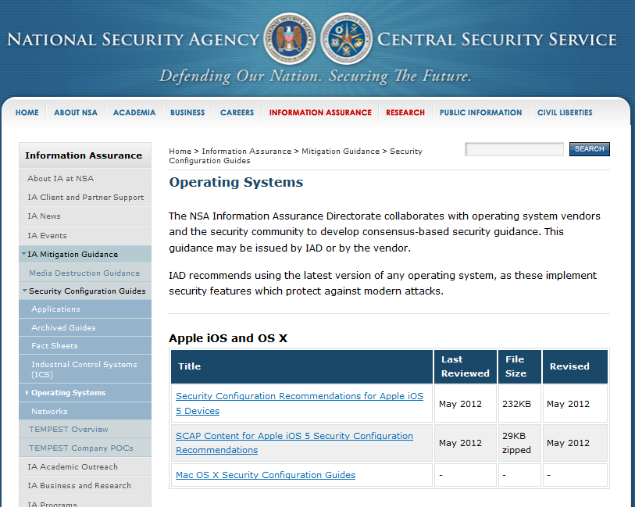
OS Configuration Guidelines
SJW

Slide 20
Checklists
The National Checklist Repository is a publicly available resource that contains information on a variety of security configuration checklists for specific IT products or categories of IT products. A security configuration checklist is a series of instructions or procedures for configuring an IT product to a particular operational environment, for verifying that the product has been configured properly, and/or for identifying unauthorized changes to the product.
Can comprise templates or automated scripts, patch information, Extensible Markup Language (XML) files, and other procedures; intended to be tailored by each organization to meet its particular security and operational requirements. Checklists created by vendors for their own products; also created by other organizations, such as academia, consortia, and government agencies. The use of well-written, standardized checklists can markedly reduce the vulnerability exposure of IT products. Checklists can be particularly helpful to small organizations and to individuals with limited resources for securing their systems.
SJW
Notes:
The first critical step in securing a system is to secure the base operating system upon
which all other applications and services rely. A good security foundation needs a
properly installed, patched, and configured operating system. Unfortunately, the
default configuration for many operating systems often maximizes ease of use and
functionality, rather than security. Further, since every organization has its own
security needs, the appropriate security profile, and hence configuration, will also
differ. What is required for a particular system should be identified during the
planning phase, as we have just discussed.
While the details of how to secure each specific operating system differ, the
broad approach is similar. Appropriate security configuration guides and checklists
exist for most common operating systems, and these should be consulted, though
always informed by the specific needs of each organization and their systems. In
some cases, automated tools may be available to further assist in securing the system
configuration.
[SCAR08] suggests the following basic steps should be used to secure an operating
system:
• install and patch the operating system
• harden and configure the operating system to adequately address the identified
security needs of the system by:
• removing unnecessary services, applications, and protocols
• configuring users, groups, and permissions
• configuring resource controls
• install and configure additional security controls, such as anti-virus, host-based
firewalls, and intrusion detection systems (IDS), if needed
• test the security of the basic operating system to ensure that the steps taken
adequately address its security needs

Slide 21
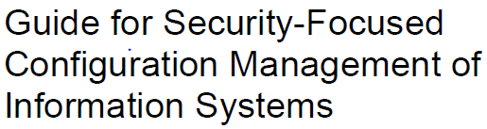
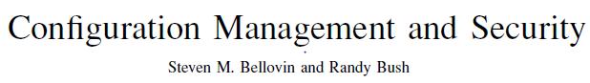
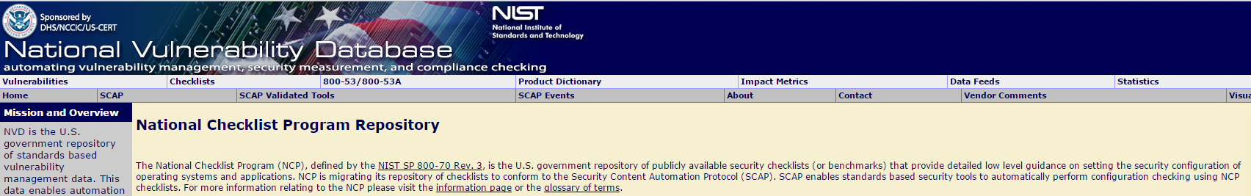
Configuration Management
SJW

Slide 22
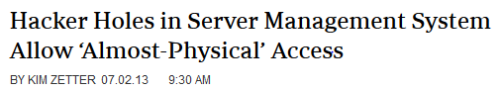
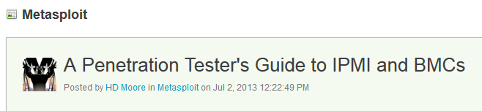
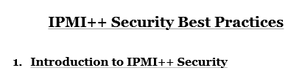
Remote Management
IPMI: Intelligent Platform Management Interface
SJW

Slide 23
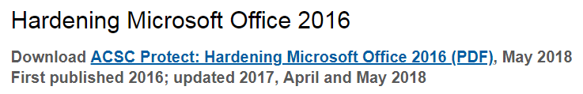
Application Configuration
May include:
Creating and specifying appropriate data storage areas for application
Making appropriate changes to the application or service default configuration details
Some applications or services may include:
Default data
Scripts
User accounts
Of particular concern with remotely accessed services such as Web and file transfer services
Risk from this form of attack is reduced by ensuring that most of the files can be read, but not written, by the server
SJW
Notes:
Any application-specific configuration is then performed. This may include creating and specifying appropriate data storage areas for the application and making appropriate changes to the application or service default configuration details.
Some applications or services may include default data, scripts, or user accounts. These should be reviewed, only retained if required, and suitably secured. A well-known example of this is found with Web servers, which often include a number of example scripts, quite a few of which are known to be insecure. These should not be used as supplied, but should be removed unless needed and secured.
As part of the configuration process, careful consideration should be given to the access rights granted to the application. Again, this is of particular concern with remotely accessed services, such as Web and file transfer services. The server application should not be granted the right to modify files unless that function is specifically required. A very common configuration fault seen with Web and file transfer servers is for all the files supplied by the service to be owned by the same “user” account that the server executes as. The consequence is that any attacker able to exploit some vulnerability in either the server software or a script executed by the server may be able to modify any of these files. The large number of “Web defacement” attacks is clear evidence of this type of insecure configuration. Much of the risk from this form of attack is reduced by ensuring that most of the files can be read, but not written, by the server. Only those files that need to be modified, to store uploaded form data or logging files, for example, should be writeable by the server. Instead the files should mostly be owned and modified by the users on the system who are responsible for maintaining the information.

Slide 24
Encryption Technology
Is a key enabling technology that may be used to secure data both in transit and when stored
Must be configured and appropriate cryptographic keys created, signed, and secured
If secure network services are provided using T L S or IPsec suitable public and private keys must be generated for each of them
If secure network services are provided using S S H, an appropriate server and client keys must be created
Cryptographic file systems are another use of encryption
Notes:
Encryption is a key enabling technology that may be used to secure data both in transit and when stored, as we discuss in Chapter 2 and in Parts Four and Five. If such technologies are required for the system, then they must be configured and appropriate cryptographic keys created, signed, and secured.
If secure network services are provided, most likely using either T L S or I Psec, then suitable public and private keys must be generated for each of them. Then X.509 certificates are created and signed by a suitable certificate authority, linking each service identity with the public key in use, as we discuss in Section 23.2 . If secure remote access is provided using Secure Shell (S S H), then an appropriate server, and possibly client keys, must be created.
Cryptographic file systems are another use of encryption. If desired, these must be created and secured with suitable keys.

Slide 25
Security Maintenance
Process of maintaining security is continuous
Security maintenance includes:
Monitoring and analyzing logging information
Performing regular backups
Recovering from security compromises
Regularly testing system security
Using appropriate software maintenance processes to patch and update all critical software and to monitor and revise configuration as needed
Notes:
Once the system is appropriately built, secured, and deployed, the process of maintaining security is continuous. This results from the constantly changing environment, the discovery of new vulnerabilities, and the exposure to new threats.
N I S T S P 800-123 suggests that this process of security maintenance includes the following additional steps:
• Monitoring and analyzing logging information
• Performing regular backups
• Recovering from security compromises
• Regularly testing system security
• Using appropriate software maintenance processes to patch and update all critical software and to monitor and revise configuration as needed
We have already noted the need to configure automatic patching and update where possible or to have a timely process to manually test and install patches on high-availability systems. We have also noted that the system should be regularly tested using checklist or automated tools where possible. We will discuss the process of incident response in Section 17.4. We now consider the critical logging and backup procedures.

Slide 26
Logging
Can only inform you about bad things that have already happened
In the event of a system breach or failure, system administrators can more quickly identify what happened
Key is to ensure that you capture the correct data and then appropriately monitor and analyze these data
Information can be generated by the system, network and applications
Range of data acquired should be determined during the system planning stage
Generates significant volumes of information and it is important that sufficient space is allocated for it
Automated analysis is preferred
Will return to logging in Chapter 18
SJW
Notes:
N I S T S P 800-123 notes that “logging is a cornerstone of a sound security posture.” Logging is a reactive control that can only inform you about bad things that have already happened. But effective logging helps ensure that in the event of a system breach or failure, system administrators can more quickly and accurately identify what happened and thus most effectively focus their remediation and recovery efforts. The key is to ensure that you capture the correct data in the logs and are then able to appropriately monitor and analyze these data. Logging information can be generated by the system, network and applications. The range of logging data acquired should be determined during the system planning stage, as it depends on the security requirements and information sensitivity of the server.
Logging can generate significant volumes of information. It is important that sufficient space is allocated for it. A suitable automatic log rotation and archive system should also be configured to assist in managing the overall size of the logging information.
Manual analysis of logs is tedious and is not a reliable means of detecting adverse events. Rather, some form of automated analysis is preferred, as it is more likely to identify abnormal activity.
We discuss the process of logging further in Chapter 18 .

Slide 27
Data Backup and Archive (1 of 2)
Performing regular backups of data is a critical control that assists with maintaining the integrity of the system and user data
May be legal or operational requirements for the retention of data
Backup
The process of making copies of data at regular intervals
Archive
The process of retaining copies of data over extended periods of time in order to meet legal and operational requirements to access past data
Note the difference!
SJW
Notes:
Performing regular backups of data on a system is another critical control that assists with maintaining the integrity of the system and user data. There are many reasons why data can be lost from a system, including hardware or software failures or accidental or deliberate corruption. There may also be legal or operational requirements for the retention of data. Backup is the process of making copies of data at regular intervals, allowing the recovery of lost or corrupted data over relatively short time periods of a few hours to some weeks. Archive is the process of retaining copies of data over extended periods of time, being months or years, in order to meet legal and operational requirements to access past data. These processes are often linked and managed together, although they do address distinct needs.
The needs and policy relating to backup and archive should be determined during the system planning stage. Key decisions include whether the backup copies are kept online or offline and whether copies are stored locally or transported to a remote site. The trade-offs include ease of implementation and cost versus greater security and robustness against different threats.
A good example of the consequences of poor choices here was seen in the attack on an Australian hosting provider in early 2011. The attackers destroyed not only the live copies of thousands of customers’ sites, but also all of the online backup copies. As a result, many customers who had not kept their own backup copies lost all of their site content and data, with serious consequences for many of them and for the hosting provider as well. In other examples, many organizations that only retained onsite backups have lost all their data as a result of fire or flooding in their IT center. These risks must be appropriately evaluated.

Slide 28
Data Backup and Archive (2 of 2)
Needs and policy relating to backup and archive should be determined during the system planning stage
Kept online or offline
Stored locally or transported to a remote site
Trade-offs include ease of implementation and cost versus greater security and robustness against different threats

Slide 29
Linux/Unix Security (1 of 4)
Patch management
Keeping security patches up to date is a widely recognized and critical control for maintaining security
Application and service configuration
Most commonly implemented using separate text files for each application and service
Generally located either in the /etc directory or in the installation tree for a specific application
Individual user configurations that can override the system defaults are located in hidden “dot” files in each user’s home directory
Most important changes needed to improve system security are to disable services and applications that are not required
Notes:
Ensuring that system and application code is kept up to date with security patches is a widely recognized and critical control for maintaining security.
Modern Unix and Linux distributions typically include tools for automatically downloading and installing software updates, including security updates, which can minimize the time a system is vulnerable to known vulnerabilities for which patches exist. For example, Red Hat, Fedora, and CentO S include up2date or yum; S u S E includes yast; and Debian uses apt-get, though you must run it as a cron job for automatic updates. It is important to configure whichever update tool is provided on the distribution in use to install at least critical security patches in a timely manner.
As noted earlier, high-availability systems that do not run automatic updates because they may possibly introduce instability, should validate all patches on test systems before deploying them to production systems.
Configuration of applications and services on Unix and Linux systems is most commonly implemented using separate text files for each application and service. System-wide configuration details are generally located either in the /etc directory or in the installation tree for a specific application. Where appropriate, individual user configurations that can override the system defaults are located in hidden “dot” files in each user’s home directory. The name, format, and usage of these files are very much dependent on the particular system version and applications in use. Hence the systems administrators responsible for the secure configuration of such a system must be suitably trained and familiar with them.
Traditionally, these files were individually edited using a text editor, with any changes made taking effect either when the system was next rebooted or when the relevant process was sent a signal indicating that it should reload its configuration settings. Current systems often provide a G U I interface to these configuration files to ease management for novice administrators. Using such a manager may be appropriate for small sites with a limited number of systems. Organizations with larger numbers of systems may instead employ some form of centralized management, with a central repository of critical configuration files that can be automatically customized and distributed to the systems they manage.
The most important changes needed to improve system security are to disable services, especially remotely accessible services, and applications that are not required and to then ensure that applications and services that are needed are appropriately configured, following the relevant security guidance for each.

Slide 30
Linux/Unix Security (2 of 4)
Users, groups, and permissions
Access is specified as granting read, write, and execute permissions to each of owner, group, and others for each resource
Guides recommend changing the access permissions for critical directories and files
Local exploit
Software vulnerability that can be exploited by an attacker to gain elevated privileges
Local exploits are performed in person, manually
Remote exploit
Software vulnerability in a network server that could be triggered by a remote attacker
SJW
Notes:
As we describe in Section 4.4, Unix and Linux systems implement discretionary access control to all file system resources. These include not only files and directories but devices, processes, memory, and indeed most system resources. Access is specified as granting read, write, and execute permissions to each of owner, group, and others for each resource, as shown in Figure 4.5. These are set using the chmod command. Some systems also support extended file attributes with access control lists that provide more flexibility by specifying these permissions for each entry in a list of users and groups. These extended access rights are typically set and displayed using the getfacl and setfacl commands. These commands can also be used to specify set user or set group permissions on the resource.
Information on user accounts and group membership are traditionally stored in the /etc/passwd and /etc/group files, though modern systems also have the ability to import these details from external repositories queried using L D A P or N I S, for example. These sources of information, and indeed of any associated authentication credentials, are specified in the P A M (pluggable authentication module) configuration for the system, often using text files in the /etc/pam.d directory.
In order to partition access to information and resources on the system, users need to be assigned to appropriate groups granting them any required access. The number and assignments to groups should be decided during the system security planning process and then configured in the appropriate information repository, whether locally using the configuration files in /etc or on some centralized database. At this time, any default or generic users supplied with the system should be checked and removed if not required. Other accounts that are required but are not associated with a user who needs to login should have login capability disabled and any associated password or authentication credential removed.
Guides to hardening Unix and Linux systems also often recommend changing the access permissions for critical directories and files in order to further limit access to them. Programs that set user (setuid) to root or set group (setgid) to a privileged group are key targets for attackers. As we detail in Section 4.4, such programs execute with superuser rights or with access to resources belonging to the privileged group, no matter which user executes them. A software vulnerability in such a program can potentially be exploited by an attacker to gain these elevated privileges. This is known as a local exploit. A software vulnerability in a network server could be triggered by a remote attacker. This is known as a remote exploit.
It is widely accepted that the number and size of setuid root programs in particular should be minimized. They cannot be eliminated, as superuser privileges are required to access some resources on the system. The programs that manage user login and allow network services to bind to privileged ports are examples. However, other programs that were once setuid root for programmer convenience can function as well if made setgid to a suitable privileged group that has the necessary access to some resource. Programs to display system state or deliver mail have been modified in this way. System hardening guides may recommend further changes and indeed the removal of some such programs that are not required on a particular system.

Slide 31
Linux/Unix Security (3 of 4)
Remote access controls
Several host firewall programs may be used
Most systems provide an administrative utility to select which services will be permitted to access the system
Logging and log rotation
Should not assume that the default setting is necessarily appropriate
Notes:
Given that remote exploits are of concern, it is important to limit access to only those services required. This function may be provided by a perimeter firewall, as we discussed in Chapter 9. However, host-based firewall or network access control mechanisms may provide additional defenses. Unix and Linux systems support several alternatives for this.
The T C P Wrappers library and tcpd daemon provide one mechanism that network servers may use. Lightly loaded services may be “wrapped” using tcpd, which listens for connection requests on their behalf. It confirms that any request is permitted by configured policy before accepting it and invoking the server program to handle it. Requests that are rejected are logged. More complex and heavily loaded servers incorporate this functionality into their own connection management code using the T C P Wrappers library and the same policy configuration files. These files are /etc/ hosts.allow and /etc/hosts.deny, which should be set as policy requires.
There are several host firewall programs that may be used. Linux systems primarily now use the iptables program to configure the netfilter kernel module. This provides comprehensive, though complex, stateful packet filtering, monitoring, and modification capabilities. B S D-based systems (including Mac O S) now use the pf program with similar capabilities. Most systems provide an administrative utility to generate common configurations and to select which services will be permitted to access the system. These should be used unless there are non-standard requirements, given the skill and knowledge needed to edit these configuration files directly.
Most applications can be configured to log with levels of detail ranging from “debugging” (maximum detail) to “none.” Some middle setting is usually the best choice, but you should not assume that the default setting is necessarily appropriate.
In addition, many applications allow you to specify either a dedicated file to write application event data to or a syslog facility to use when writing log data to /dev/log. If you wish to handle system logs in a consistent, centralized manner, it’s usually preferable for applications to send their log data to /dev/log. Note, however, that logrotate can be configured to rotate any logs on the system, whether written by syslogd, Syslog-N G, or individual applications.

Slide 32
Linux/Unix Security (4 of 4)
chroot jail
Restricts the server’s view of the file system to just a specified portion
Uses chroot system call to confine a process by mapping the root of the filesystem to some other directory
File directories outside the chroot jail aren’t visible or reachable
Main disadvantage is added complexity
See Chapter 25, Linux Security (on Brightspace)
SJW
Notes:
Some network-accessible services do not require access to the full file system, but rather only need a limited set of data files and directories for their operation. F T P is a common example of such a service. It provides the ability to download files from, and upload files to, a specified directory tree. If such a server were compromised and had access to the entire system, an attacker could potentially access and compromise data elsewhere. Unix and Linux systems provide a mechanism to run such services in a chroot jail, which restricts the server’s view of the file system to just a specified portion. This is done using the chroot system call that confines a process to some subset of the file system by mapping the root of the filesystem “/” to some other directory (e.g., /srv/ ftp/public). To the “chrooted” server, everything in this chroot jail appears to actually be in / (e.g., the “real” directory /srv/ftp/public/etc/myconfigfile appears as /etc/myconfigfile in the chroot jail). Files in directories outside the chroot jail (e.g., /srv/www or /etc.) are not visible or reachable at all.
Chrooting therefore helps contain the effects of a given server being compromised or hijacked. The main disadvantage of this method is added complexity: A number of files (including all executable libraries used by the server), directories, and devices needed must be copied into the chroot jail. Determining just what needs to go into the jail for the server to work properly can be tricky, though detailed procedures for chrooting many different applications are available.
Troubleshooting a chrooted application can also be difficult. Even if an application explicitly supports this feature, it may behave in unexpected ways when run chrooted. Note also that if the chrooted process runs as root, it can “break out” of the chroot jail with little difficulty. Still, the advantages usually far outweigh the disadvantages of chrooting network services.
The system hardening guides such as those provided by the “N S A—Security Configuration Guides” include security checklists for a number of Unix and Linux distributions that may be followed.
There are also a number of commercial and open-source tools available to perform system security scanning and vulnerability testing. One of the best known is “Nessus.” This was originally an open-source tool and was commercialized in 2005, though some limited free-use versions are available. “Tripwire” is a well-known file integrity checking tool that maintains a database of cryptographic hashes of monitored files and scans to detect any changes, whether as a result of malicious attack or simply accidental or incorrectly managed update. This also was originally an open-source tool but now has both commercial and free variants available. The “Nmap” network scanner is another well-known and deployed assessment tool that focuses on identifying and profiling hosts on the target network and the network services they offer.

Slide 33
Linux/Unix Security tcpd and TCP Wrappers
tcpd
Wraps lightly loaded services
listens for connection requests
checks that any request is permitted by configured policy before invoking the server program to handle it
TCP Wrappers library
Complex and heavily loaded servers use to incorporate connection checking functionality into connection management code
Both use the same policy configuration files
/etc/hosts.allow and /etc/hosts.deny
SJW
Notes:
Some network accessible services do not require access to the full file-system, but
rather only need a limited set of data files and directories for their operation. FTP is
a common example of such a service. It provides the ability to download files from,
and upload files to, a specified directory tree. If such a server were compromised and
had access to the entire system, an attacker could potentially access and compromise
data elsewhere. Unix and Linux systems provide a mechanism to run such services in a
chroot jail , which restricts the server’s view of the file system to just a specified portion.
This is done using the chroot system call that confines a process to some subset of the file
system by mapping the root of the filesystem “/” to some other directory (e.g., /srv/
ftp/public). To the “chrooted” server, everything in this chroot jail appears to
actually be in / (e.g., the “real” directory /srv/ftp/public/etc/myconfigfile
appears as /etc/myconfigfile in the chroot jail). Files in directories outside the
chroot jail (e.g., /srv/www or /etc.) aren’t visible or reachable at all.
Chrooting therefore helps contain the effects of a given server being compromised
or hijacked. The main disadvantage of this method is added complexity: a
number of files (including all executable libraries used by the server), directories,
and devices needed must be copied into the chroot jail. Determining just what needs
to go into the jail for the server to work properly can be tricky, though detailed procedures
for chrooting many different applications are available.
Troubleshooting a chrooted application can also be difficult. Even if an application
explicitly supports this feature, it may behave in unexpected ways when run
chrooted. Note also that if the chrooted process runs as root, it can “break out” of
the chroot jail with little difficulty. Still, the advantages usually far outweigh the
disadvantages of chrooting network services.
The system hardening guides such as those provided by the “NSA—Security
Configuration Guides” include security checklists for a number of Unix and Linux
distributions that may be followed.
There are also a number of commercial and open-source tools available to perform
system security scanning and vulnerability testing. One of the best known is
“Nessus.” This was originally an open-source tool, which was commercialized in 2005,
though some limited free-use versions are available. “Tripwire” is a well-known file
integrity checking tool that maintains a database of cryptographic hashes of monitored
files, and scans to detect any changes, whether as a result of malicious attack, or simply
accidental or incorrectly managed update. This again was originally an open-source
tool, which now has both commercial and free variants available. The “Nmap” network
scanner is another well-known and deployed assessment tool that focuses on identifying
and profiling hosts on the target network, and the network services they offer.

Slide 34
Windows Security (1 of 3)
Patch management
“Windows Update” and “Windows Server Update Service” assist with regular maintenance and should be used
Third party applications also provide automatic update support
User administration and access controls
Systems implement discretionary access controls resources
Vista and later systems include mandatory integrity controls
Objects are labeled as being of low, medium, high, or system integrity level
System ensures the subject’s integrity is equal to or higher than the object’s level
Implements a form of the Biba Integrity model
Notes:
We now consider some specific issues with the secure installation, configuration, and management of Microsoft Windows systems. These systems have for many years formed a significant portion of all “general purpose” system installations. Hence, they have been specifically targeted by attackers and consequently security countermeasures are needed to deal with these challenges. The process of providing appropriate levels of security still follows the general outline we describe in this chapter.
Again, there are a large range of resources available to assist administrators of these systems, including online resources such as the “Microsoft Security Tools & Checklists” and specific system hardening guides such as those provided by the “N S A—Security Configuration Guides.”
The “Windows Update” service and the “Windows Server Update Services” assist with the regular maintenance of Microsoft software and should be configured and used. Many other third-party applications also provide automatic update support, and these should be enabled for selected applications.
Users and groups in Windows systems are defined with a Security I D (S I D). This information may be stored and used locally on a single system in the Security Account Manager (S A M). It may also be centrally managed for a group of systems belonging to a domain, with the information supplied by a central Active Directory (A D) system using the L D A P protocol. Most organizations with multiple systems will manage them using domains. These systems can also enforce common policy on users on any system in the domain.
Windows systems implement discretionary access controls to system resources such as files, shared memory, and named pipes. The access control list has a number of entries that may grant or deny access rights to a specific S I D, which may be for an individual user or for some group of users. Windows Vista and later systems also include mandatory integrity controls. These label all objects, such as processes and files, and all users as being of low, medium, high, or system integrity level. Then whenever data are written to an object, the system first ensures that the subject’s integrity is equal to or higher than the object’s level. This implements a form of the Biba Integrity model [B I B A 77], that specifically targets the issue of untrusted remote code executing in, for example, Windows Internet Explorer, to try to modify local resources.

Slide 35
Windows Security: Users Administration and Access Controls
Windows systems also define privileges
System wide and granted to user accounts
Combination of share and N T F S permissions may be used to provide additional security and granularity when accessing files on a shared resource
User Account Control (U A C)
Provided in Vista and later systems
Assists with ensuring users with administrative rights only use them when required, otherwise access the system as normal users
Low Privilege Service Accounts
Used for long-lived service processes such as file, print, and D N S services
Notes:
Windows systems also define privileges, which are system wide and granted to user accounts. Examples of privileges include the ability to back up the computer (which requires overriding the normal access controls to obtain a complete backup) or the ability to change the system time. Some privileges are considered dangerous, as an attacker may use them to damage the system. Hence they must be granted with care. Others are regarded as benign and may be granted to many or all user accounts.
As with any system, hardening the system configuration can include further limiting the rights and privileges granted to users and groups on the system. Because the access control list gives deny entries greater precedence, you can set an explicit deny permission to prevent unauthorized access to some resource, even if the user is a member of a group that otherwise grants access.
When accessing files on a shared resource, a combination of share and N T F S permissions may be used to provide additional security and granularity. For example, you can grant full control to a share but read-only access to the files within it. If access-based enumeration is enabled on shared resources, it can automatically hide any objects that a user is not permitted to read. This is useful with shared folders
containing many users’ home directories, for example.
You should also ensure that users with administrative rights use them only when required and otherwise access the system as normal users. The User Account Control (U A C) provided in Vista and later systems assists with this requirement. These systems also provide Low Privilege Service Accounts that may be used for long-lived service processes, such as file, print, and D N S services that do not require elevated privileges.

Slide 36
Windows Security (2 of 3)
Application and service configuration
Much of the configuration information is centralized in the Registry
Forms a database of keys and values that may be queried and interpreted by applications
Registry keys can be directly modified using the “Registry Editor”
More useful for making bulk changes
See Chapter 26, Windows Security (on Brightspace)
SJW
Notes:
Unlike Unix and Linux systems, much of the configuration information in Windows systems is centralized in the Registry, which forms a database of keys and values that may be queried and interpreted by applications on these systems.
Changes to these values can be made within specific applications, setting preferences in the application that are then saved in the registry using the appropriate keys and values. This approach hides the detailed representation from the administrator. Alternatively, the registry keys can be directly modified using the “Registry Editor.” This approach is more useful for making bulk changes, such as those recommended in hardening guides. These changes may also be recorded in a central repository and pushed out whenever a user logs in to a system within a network domain.
Given the predominance of malware that targets Windows systems, it is essential that suitable anti-virus, anti-spyware, personal firewall, and other malware and attack detection and handling software packages are installed and configured on such systems. This is clearly needed for network connected systems, as shown by the high-incidence numbers in reports such as [V E R I 22]. However, as the Stuxnet attacks in 2010 show, even isolated systems updated using removable media are vulnerable and thus must also be protected.

Slide 37
Windows Security (3 of 3)
Other security controls
Essential that anti-virus, anti-spyware, personal firewall, and other malware and attack detection and handling software packages are installed and configured
Current generation Windows systems include basic firewall and malware countermeasure capabilities
Important to ensure the set of products in use are compatible
Windows systems also support a range of cryptographic functions:
Encrypting files and directories using the Encrypting File System (E F S)
Full-disk encryption with A E S using BitLocker
Notes:
Current generation Windows systems include some basic firewall and malware countermeasure capabilities, which should certainly be used at a minimum. However, many organizations find that these should be augmented with one or more of the many commercial products available. One issue of concern is undesirable interactions between anti-virus and other products from multiple vendors. Care is needed when planning and installing such products to identify possible adverse interactions and to ensure the set of products in use are compatible with each other.
Windows systems also support a range of cryptographic functions that may be used where desirable. These include support for encrypting files and directories using the Encrypting File System (E F S) and for full-disk encryption with A E S using BitLocker.
The system hardening guides such as those provided by the “N S A—Security Configuration Guides” also include security checklists for various versions of Windows.
There are also a number of commercial and open-source tools available to perform system security scanning and vulnerability testing of Windows systems. Larger organizations are likely better served using one of the larger, centralized, commercial security analysis suites available.

Slide 38
Virtualization
A technology that provides an abstraction of the resources used by some software which runs in a simulated environment called a virtual machine (V M)
Benefits include better efficiency in the use of the physical system resources
Provides support for multiple distinct operating systems and associated applications on one physical system
Raises additional security concerns
Abstraction: reducing something to a set of essential characteristics
Virtual Machine products: VMware, QEMU/KVM, Virtual Box, Parallels, MS Hyper-V, Xen
SJW
Notes:
Virtualization refers to a technology that provides an abstraction of the computing resources used by some software, which thus runs in a simulated environment called a virtual machine (V M). There are many types of virtualization; however, in this section we are most interested in full virtualization. This allows multiple full operating system instances to execute on virtual hardware, supported by a hypervisor that manages access to the actual physical hardware resources. Benefits arising from using virtualization include better efficiency in the use of the physical system resources than is typically seen using a single operating system instance. This is particularly evident in the provision of virtualized server systems. Virtualization can also provide support for multiple distinct operating systems and associated applications on the one physical system. This is more commonly seen on client systems.
There are a number of additional security concerns raised in virtualized systems as a consequence both of the multiple operating systems executing side by side and of the presence of the virtualized environment and hypervisor as a layer below the operating system kernels and the security services they provide. [C L E E 09] presents a survey of some of the security issues arising from such a use of virtualization, a number of which we will discuss further.

Slide 39
Virtualization
Conventional machine
Virtualized machine
SJW

Slide 40
Hypervisor
Software that sits between the hardware and the V M s
Acts as a resource broker
It allows multiple V M s to safely coexist on a single physical server host and share that host’s resources
Virtualizing software provides abstraction of all physical resources and thus enables multiple computing stacks, called virtual machines, to be run on a single physical host
Each V M includes an O S, called the guest O S
This O S may be the same as the host O S, if present, or a different one
Notes:
The hypervisor is software that sits between the hardware and the V M s and acts as a resource broker. Simply put, it allows multiple V M s to safely coexist on a single physical server host and share that host’s resources. The virtualizing software provides abstraction of all physical resources (such as processor, memory, network, and storage) and thus enables multiple computing stacks, called virtual machines, to be run on a single physical host.
Each V M includes an O S, called the guest O S. This O S may be the same as the host O S, if present, or a different one. For example, a guest Windows O S could be run in a V M on top of a Linux host O S. The guest O S, in turn, supports a set of standard library functions and other binary files and applications. From the point of view of the applications and the user, this stack appears as an actual machine with hardware and an O S; thus, the term virtual machine is appropriate. In other words, it is the hardware that is being virtualized.

Slide 41
Hypervisor Functions
The principal functions performed by a hypervisor are:
Execution management of V M s
Device emulation and access control
Execution of privileged operations by hypervisor for guest V M s
Management of V M s (also called V M lifecycle management)
Administration of hypervisor platform and hypervisor software
Notes:
The principal functions performed by a hypervisor are the following:
• Execution management of V M s: Includes scheduling V M s for execution, virtual memory management to ensure V M isolation from other V M s, and context switching between various processor states. Also includes isolation of V M s to prevent conflicts in resource usage and emulation of timer and interrupt mechanisms.
• Devices emulation and access control: Emulating all network and storage(block) devices that different native drivers in V M s are expecting and mediating access to physical devices by different V M s.
• Execution of privileged operations by hypervisor for guest V M s: Certain operations invoked by guest O S s, instead of being executed directly by the host hardware, may have to be executed on its behalf by the hypervisor because of their privileged nature.
• Management of V M s (also called V M lifecycle management): Configuring guest V M s and controlling V M states (e.g., Start, Pause, Stop).
• Administration of hypervisor platform and hypervisor software: Involves the setting of parameters for user interactions with the hypervisor host as well as hypervisor software.

Slide 42
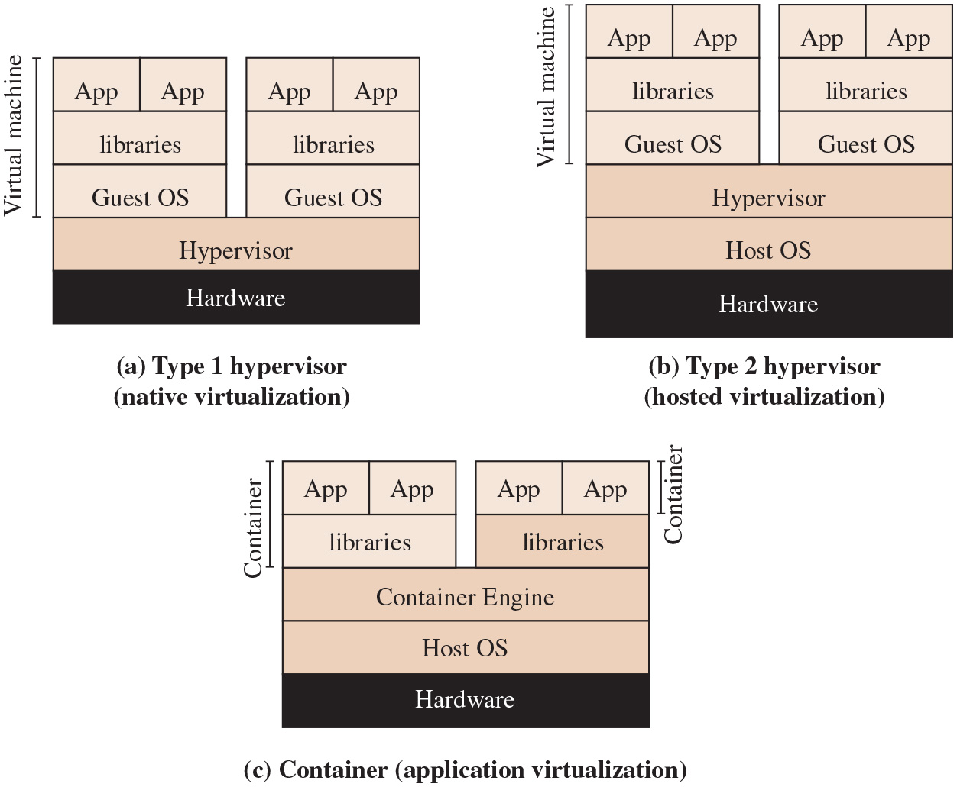
Figure 12.2
Comparison of Virtual Machines and Containers
Used on client machines
SJW
Notes:
Long Description:
Part (a): Type 1 hypervisor, native virtualization. The hypervisor is stacked on the hardware, and two virtual machines are stacked on the hypervisor. Both the virtual machine have the following layers from bottom to top. Guest O S, libraries, applications.
Part (b): Type 2 hypervisor, hosted virtualization. A host O S is installed between the hardware and hype visor in the structure from part (a), while the virtual machines are stacked in the same manner.
Part (c): Container, application virtualization. The basic structure has the following three layers from bottom to top. Hardware, host O S, container engine. Two sets of Libraries and applications are stacked on the container engine. The left stack contains both the library and application layers labeled as the container. While the right stack contains the applications alone are labeled as the container.

Slide 43
Virtualized Systems
In virtualized systems, the available hardware resources must be appropriately shared among the various guest O S s
These include C P U, memory, disk, network, and other attached devices
C P U and memory are generally partitioned between these, and scheduled as required
Disk storage may be partitioned, with each guest having exclusive use of some disk resources
Alternatively, a “virtual disk” may be created for each guest, which appears to it as a physical disk with a full file-system but is viewed externally as a single ”disk image” file on the underlying file-system
Attached devices such as optical disks or U S B devices are generally allocated to a single guest O S at a time
Notes:
In virtualized systems, the available hardware resources must be appropriately shared among the various guest O S s. These include C P U, memory, disk, network, and other attached devices. C P U and memory are generally partitioned between these and scheduled as required. Disk storage may be partitioned, with each guest having exclusive use of some disk resources. Alternatively, a “virtual disk” may be created for each guest, which appears to it as a physical disk with a full file-system but is viewed externally as a single “disk image” file on the underlying file-system. Attached devices such as optical disks or U S B devices are generally allocated to a single guest O S at a time.
Several alternatives exist for providing network access. The guest O S may have direct access to distinct network interface cards on the system, the hypervisor may mediate access to shared interfaces, or the hypervisor may implement virtual network interface cards for each guest, bridging or routing traffic between guests as required. This last approach uses one or more virtual network switches, which are implemented in the hypervisor kernel, and is quite common. It is arguably the most efficient approach since traffic between guests does not need to be relayed via external network links. It does have security consequences in that this traffic is not subject to monitoring by probes attached to physical networks, such as we discussed in Chapter 9.
When a number of virtualized systems and hypervisors are grouped together in a data center, or even between data centers, the various systems need to connect to appropriate network segments, with suitable routing and firewalls connecting them together, and to the Internet. The cloud computing solutions we will discuss in Chapter 13 use this structure, as do computing solutions for some large organizations. The network connections can be made with physical, external links using I D S and firewalls to link them together as we discussed in Chapters 8 and 9. However, this approach limits the flexibility of the virtualized solution, as virtual machines can only be migrated to other hosts with the required physical network connections already in place. V L A N s can provide more flexibility in the network architecture but are still limited by the physical network connections and V L A N configuration.

Slide 44
Software-Defined Networks (S D N s)
S D N s enable network segments to logically span multiple servers within and between data centers, while using the same underlying physical network
There are several possible approaches to providing S D N s, including the use of overlay networks
These abstract all layer 2 and 3 addresses from the underlying physical network into whatever logical network structure is required
This structure can be easily changed and extended as needed
The I E T F standard D O V E (Distributed Overlay Virtual Network) which uses V X L A N (Virtual Extended Local Area Network) can be used to implement such an overlay network
With this flexible structure, it is possible to locate virtual servers, virtual I D S s, and virtual firewalls anywhere within the network as required
Notes:
Greater flexibility still is provided by software-defined networks (S D N s), which enable network segments to logically span multiple servers within and between data centers while using the same underlying physical network. There are several possible approaches to providing S D N s, including the use of overlay networks. These abstract all layer 2 and 3 addresses from the underlying physical network into whatever logical network structure is required. And this structure can be easily changed and extended as needed. The I E T F standard D O V E (Distributed Overlay Virtual Network), which uses V X L A N (Virtual Extended Local Area Network) can be used to implement such an overlay network. With this flexible structure, it is possible to locate virtual servers, virtual I D S s, and virtual firewalls anywhere within the network as required. We further discuss the use of secure virtual networks and firewalls later in this section.

Slide 45
Containers
A recent approach to virtualization is known as container virtualization or application virtualization
In this approach, software known as a virtualization container, runs on top of the host O S kernel and provides an isolated execution environment for applications
Unlike hypervisor-based V M s, containers do not aim to emulate physical servers
All containerized applications on a host share a common O S kernel
For containers, only a small container engine is required as support
Containerization sits between the O S and applications and incurs lower overhead but potentially introduces greater security vulnerabilities
Notes:
A relatively recent approach to virtualization, known as container virtualization or application virtualization, is worth noting (see Figure 12.2c). In this approach, software known as a virtualization container runs on top of the host O S kernel and provides an isolated execution environment for applications. Unlike hypervisor- based V M s, containers do not aim to emulate physical servers. Instead, all containerized applications on a host share a common O S kernel. This eliminates the resources needed to run a separate O S for each application and can greatly reduce overhead.
For containers, only a small container engine is required as support. The container engine sets up each container as an isolated instance by requesting dedicated resources from the O S for each container. Each container app then directly uses the resources of the host O S. V M virtualization functions at the border of hardware and O S. It’s able to provide strong performance isolation and security guarantees with the narrowed interface between V M s and hypervisors. Containerization, which sits between the O S and applications, incurs lower overhead but potentially introduces greater security vulnerabilities.

Slide 46
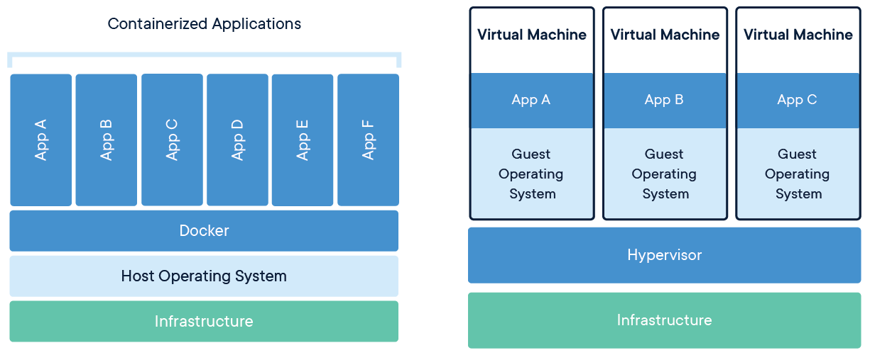
Container Manager (Docker) vs. VM
Docker is a container manager
Applications are deployed in container instances
Containers are logically isolated and can be migrated
Single OS instance – lower overhead with containers
Docker is a container manager
Applications are deployed in container instances
Containers are logically isolated and can be migrated
Single OS instance – lower overhead with containers
SJW

Slide 47
Virtualization Security Issues
Security concerns include:
Guest O S isolation
Ensuring that programs executing within a guest O S may access and use only the resources allocated to it
Guest O S monitoring by the hypervisor
Which has privileged access to the programs and data in each guest O S
Virtual machine introspection is a powerful technique for determining the specific aspects of guest VM execution from outside the VM
Virtualized environment security
Particularly image and snapshot management which attackers may attempt to view or modify
SJW
Notes:
[C L E E 09] and N I S T S P 800-125 (Guide to Security for Full Virtualization Technologies, January 2011) both detail a number of security concerns that result from the use of virtualized systems, including:
• Guest O S isolation, ensuring that programs executing within a guest O S may access and use only the resources allocated to it and not covertly interact with programs or data in other guest O S s or in the hypervisor.
• Guest O S monitoring by the hypervisor, which has privileged access to the programs and data in each guest O S and must be trusted as secure from subversion and compromised use of this access
• Virtualized environment security, particularly image and snapshot management, which attackers may attempt to view or modify.
These security concerns may be regarded as an extension of the concerns we have already discussed with securing operating systems and applications. If a particular operating system and application configuration is vulnerable when running directly on hardware in some context, it will most likely also be vulnerable when running in a virtualized environment. And should that system actually be compromised, it would be at least as capable of attacking other nearby systems, whether they are also executing directly on hardware or running as other guests in a virtualized environment. The use of a virtualized environment may improve security by further isolating network traffic between guests than would be the case when such systems run natively; however, this traffic is not visible to external I D S or firewall systems and may require the use of virtual firewalls to manage. Furthermore, the ability of the hypervisor to transparently monitor activity on all guest O S s may be used as a form of virtual firewall or I D S to assist in securing these systems. However, the presence of the virtualized environment and the hypervisor may reduce security if vulnerabilities that attackers may exploit exist within it. Such vulnerabilities could allow programs executing in a guest to covertly access the hypervisor and, hence, other guest O S resources. This is known as V M escape and is of concern, as we discussed in Section 6.8. Virtualized systems also often provide support for suspending an executing guest O S in a snapshot, saving that image and then restarting execution at a later time, possibly even on another system. If an attacker can view or modify this image, they can compromise the security of the data and programs contained within it. The use of infrastructure with many virtualized systems within and between data centers, linked using software-defined networks, raise further security concerns.
Thus, the use of virtualization adds additional layers of concern, as we have previously noted. Securing virtualized systems means extending the security process to secure and harden these additional layers. In addition to securing each guest operating system and applications, the virtualized environment and the hypervisor must also be secured.

Slide 48
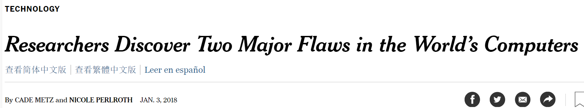
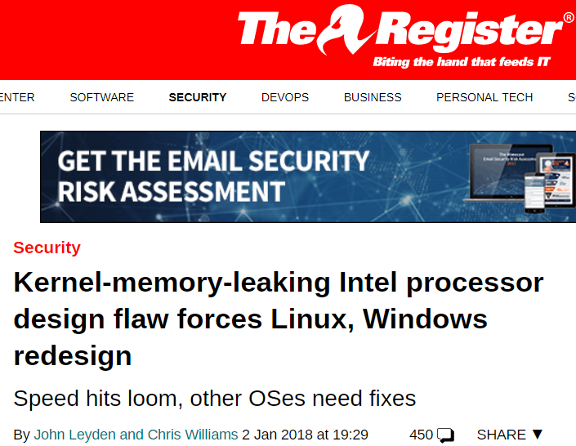
Recent Issues
Meltdown:
Affects Intel microprocessors
Used in 90% of servers
Ordinary user programs can access kernel memory
Fix could slow performance by up to 30%
Vulnerability details embargoed
Spectre:
Affects most processors
Intel, AMD, ARM
Difficult to exploit
No known fix
SJW

Slide 49
Securing Virtualization Systems
Organizations using virtualization should:
Carefully plan the security of the virtualized system
Secure all elements of a full virtualization solution and maintain their security
Ensure that the hypervisor is properly secured (Hyperjacking)
Restrict and protect administrator access to the virtualization solution
SJW
Notes:
N I S T S P 800-125 provides guidance for providing appropriate security in virtualized systems and states that organizations using virtualization should:
• Carefully plan the security of the virtualized system
• Secure all elements of a full virtualization solution, including the hypervisor, guest O S s, and virtualized infrastructure, and maintain their security
• Ensure that the hypervisor is properly secured
• Restrict and protect administrator access to the virtualization solution
This is clearly seen as an extension of the process of securing systems that we presented earlier in this chapter.

Slide 50
Hypervisor Security
Should be
Secured using a process similar to securing an operating system
Installed in an isolated environment
Configured so that it is updated automatically
Monitored for any signs of compromise
Accessed only by authorized administration
May support both local and remote administration so must be configured appropriately
Remote administration access should be considered and secured in the design of any network firewall and I D S capability in use
Ideally administration traffic should use a separate network with very limited access provided from outside the organization
Notes:
The hypervisor should be secured using a process similar to that of securing an operating system. That is, it should be installed in an isolated environment, from known clean media, and updated to the latest patch level in order to minimize the number of vulnerabilities that may be present. It should then be configured so that it is updated automatically, any unused services are disabled or removed, unused hardware is disconnected, appropriate introspection capabilities are used with the guest O S s, and the hypervisor is monitored for any signs of compromise.
Access to the hypervisor should be limited to authorized administrators only, since these users would be capable of accessing and monitoring activity in any of the guest O S s. The hypervisor may support both local and remote administration. This must be configured appropriately, with suitable authentication and encryption mechanisms used, particularly when using remote administration. Remote administration access should also be considered and secured in the design of any network firewall and I D S capability in use. Ideally, such administration traffic should use a separate network with very limited, if any, access provided from outside the organization.

Slide 51
Virtualized Infrastructure Security
Systems manage access to hardware resources
Access must be limited to just the appropriate guest O S s
Access to V M image and snapshots must be carefully controlled
Notes:
The wider virtualization infrastructure must be carefully managed and configured. Virtualized system hypervisors manage access to hardware resources such as disk storage and network interfaces. This access must be limited to just the appropriate guest O S s that use any resource, and network connections must be suitably arranged. Access to V M images and snapshots must also be carefully controlled, since these are another potential point of attack.
When multiple virtualized systems are used, N I S T S P 800-125B (Secure Virtual Network Configuration for Virtual Machine (V M) Protection, March 2016) notes three distinct categories of network traffic:
• Management traffic: used for hypervisor administration and configuration of the virtualized infrastructure.
• Infrastructure traffic: such as migration of V M images, or connections to network storage technologies.
• Application traffic: between applications running V M s and to external networks. This traffic may be further separated into a number of segments, isolating traffic from applications with different sensitivity levels, or from different organizations or departments.
Traffic in each of these should be suitably isolated and protected. This requires the use of a number of network segments, connected as needed by appropriate firewall systems. These may variously use a combination of distinct physical network connections, V L A N s, or software-defined networks to provide a suitable network structure. For example, in larger installations, management and infrastructure traffic may use relatively static physical network connections, while the application traffic would use more flexible V L A N s or software-defined networks layered over a separate base physical network structure.

Slide 52
Virtual Firewall
Provides firewall capabilities for the network traffic flowing between systems hosted in a virtualized or cloud environment that does not require this traffic to be routed out to a physically separate network supporting traditional firewall services
V M Bastion Host
Where a separate V M is used as a bastion host supporting the same firewall systems and services that could be configured to run on a physically separate bastion, including possibly I D S and I P S services
V M Host-Based Firewall
Where host-based firewall capabilities provided by the guest O S running on the V M are configured to secure that host in the same manner as used in physically separate systems
Hypervisor Firewall
Where firewall capabilities are provided directly by the hypervisor
Notes:
As we mentioned in Section 9.4, a virtual firewall provides firewall capabilities for the network traffic flowing between systems hosted in a virtualized or cloud environment that does not require this traffic to be routed out to a physically separate network supporting traditional firewall services. These capabilities may be provided by a combination of:
• V M Bastion Host: Where a separate V M is used as a bastion host supporting the same firewall systems and services that could be configured to run on a physically separate bastion, including possibly I D S and I P S services. The network connections used by other V M s are configured to connect them to suitable sub-networks. These are connected to distinct virtual network interfaces on the V M Bastion Host, which can monitor and route traffic between them in the same manner and with the same configuration possibilities as on a physically separate bastion host. Such systems may be provided as a virtual U T M installed into a suitably hardened V M that can be easily loaded, configured, and run as needed. A disadvantage of this approach is that these virtual bastions compete for the same hypervisor host resources as other V M s on that system.
• V M Host-Based Firewall: Where host-based firewall capabilities provided by the guest O S running on the V M are configured to secure that host in the same manner as used in physically separate systems.
• Hypervisor Firewall: Where firewall capabilities are provided directly by the hypervisor. These capabilities range from stateless or stateful packet inspection in the virtual network switches that forward network traffic between V M s, to a full hypervisor firewall capable of monitoring all activity within its V M s. This latter variant provides capabilities of both host-based and bastion host firewalls, but from a location outside the traditional host and network structure. It can be more secure than the other alternatives, as it is not part of the virtualized network, nor is it visible as a separate V M. It may also be more efficient than the alternatives, since the resource monitoring and filtering occur within the hypervisor kernel running directly on the hardware. However, it requires a hypervisor that supports these features, which also adds to its complexity.
When used in large-scale virtualized environments with many virtualized systems linked with V L A N s or software-defined networks across one or more data centers, virtual firewall bastions can be provisioned and located as needed where suitable resources are available. This provides a greater level of flexibility and scalability than many traditional structures can support. However, there may still be a need for some physical firewall systems, especially to support very high traffic volumes either between virtual servers or on their connection to the wider Internet.

Slide 53
Hosted Virtualization Security
Hosted virtualized systems (used on client systems) pose additional security concerns that result from the host O S under the hypervisor and its guest OSes
Users have access to configure the hypervisor and to any V M images and snapshots
Possible to design a host system and virtualization solution that is more protected from access and modification by the users
There will be security concerns from possible compromise unless it is adequately secured and managed
SJW
Notes:
Hosted virtualized systems, as typically used on client systems, pose some additional security concerns. These result from the presence of the host OS under, and other host applications beside, the hypervisor and its guest OSs. Hence, there are yet more layers to secure. Further, the users of such systems often have full access to configure the hypervisor and to any VM images and snapshots. In this case, the use of virtualization is more to provide additional features and to support multiple operating systems and applications than to isolate these systems and data from each other and from the users of these systems.
It is possible to design a host system and virtualization solution that is more protected from access and modification by the users. This approach may be used to
support well-secured guest O S images used to provide access to enterprise networks and data and to support central administration and update of these images. However, there will remain security concerns from possible compromise of the underlying host O S unless it is adequately secured and managed.

Slide 54
Trusted Computer Systems
Design and implementation concerns:
Difficult to be assured that the design provides intended level of security
Even if the design is correct, it is difficult to implement the design without errors or bugs.
These problems have led to a desire to develop a method to prove that a design satisfies security requirements and that the implementation of that design conforms to the design specification
Because of cost and performance issues, trusted computer systems did not gain a serious foothold in the commercial market
From Chapter Four, not covered
SJW
Notes:
To provide strong computer security involves both design and implementation. It is difficult, in designing any hardware or software module, to be assured that the design does in fact provide the level of security that was intended. This difficulty results in many unanticipated security vulnerabilities. Even if the design is in some sense correct, it is difficult, if not impossible, to implement the design without errors or bugs, providing yet another host of vulnerabilities. These problems have led to a desire to develop a method to prove, logically or mathematically, that a particular design does satisfy a stated set of security requirements and that the implementation of that design faithfully conforms to the design specification. Initially, research in this area was funded by the U.S. Department of Defense and considerable progress was made in developing models and in applying them to prototype systems. This work was based on the Bell-LaPadula (BLP) model that we introduced in Section 4.5. Because of cost and performance issues, trusted computer systems did not gain a serious foothold in the commercial market. More recently, the interest in trust has re-emerged, with the work on trusted computer platforms, a topic we explore in the next section.

Slide 55
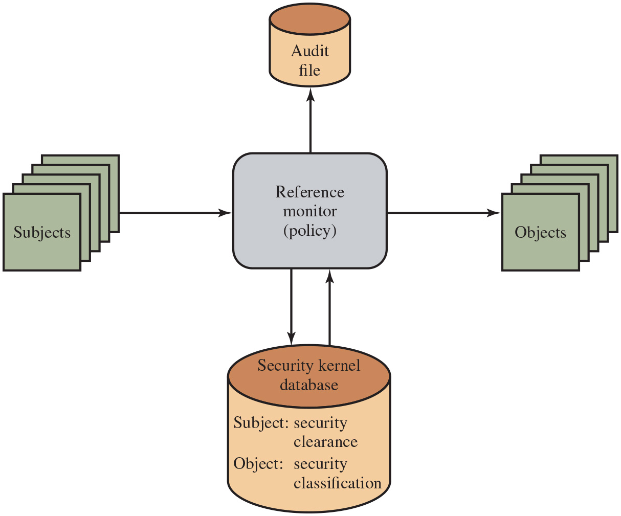
Figure 12.3
Reference Monitor Concept
Notes:
Initial work on trusted computers and trusted operating systems was based on the reference monitor concept, depicted in Figure 12.3. The reference monitor is a controlling element in the hardware and operating system of a computer that regulates the access of subjects to objects on the basis of security parameters of the subject and object. The reference monitor has access to a file, known as the security kernel database, that lists the access privileges (security clearance) of each subject and the protection attributes (classification level) of each object. The reference monitor enforces the security rules from the Bell-LaPadula model (no read up, no write down) and has the following properties:
Complete mediation: The security rules are enforced on every access, not just, for example, when a file is opened.
• Isolation: The reference monitor and database are protected from unauthorized modification.
• Verifiability: The reference monitor’s correctness must be provable. That is, it must be possible to demonstrate mathematically that the reference monitor enforces the security rules and provides complete mediation and isolation.
These are stiff requirements. The requirement for complete mediation means that every access to data within main memory and on disk and tape must be mediated. Pure software implementations impose too high a performance penalty to be practical; the solution must be at least partly in hardware. The requirement for isolation means it must not be possible for an attacker, no matter how clever, to change the logic of the reference monitor or the contents of the security kernel database.
Finally, the requirement for mathematical proof is formidable for something as complex as a general-purpose computer. A system that can provide such verification is referred to as a trustworthy system. A final element illustrated in Figure 12.3 is an audit file. Important security events, such as detected security violations and authorized changes to the security kernel database, are stored in the audit file.
Long Description:
The central box is labeled Reference monitor (policy). A set of stacked squares labeled Subjects are placed to the left, and an arrow extends toward right from the subjects to the reference monitor (policy). A set of squares labeled Objects are placed on the right and an arrow extends toward right from the reference monitor to the objects. A cylinder labeled Audit file is placed on the top, while an arrow extends upward from the reference monitor. A larger cylinder labeled Security kernel database is placed below the reference monitor. This cylinder is inscribed with a note Subject: security clearance, Object: security classification, with an arrow extending upward and downward between both the cylinder and the reference monitor.

Slide 56
Trusted Computer Systems – T C S E C and Common Criteria (1 of 3)
Informally known as the Orange Book in the early 1980s
Focused primarily on protecting information confidentiality
Common Criteria (C C) for Information Technology and Security Evaluation
I S O standards for specifying security requirements and defining evaluation criteria
Aim is to provide greater confidence in the security of I T products
Defines a common set of potential security requirements for use in evaluation
Target of evaluation (T O E): part of the product or system that is subject to evaluation
Notes:
The work done by the National Security Agency and other U.S. government agencies to develop requirements and evaluation criteria for trusted systems resulted in the publication of the Trusted Computer System Evaluation Criteria (T C S E C), informally known as the Orange Book, in the early 1980s. This focused primarily on protecting information confidentiality. Subsequently, other countries started work to develop criteria based on the T C S E C that were more flexible and adaptable to the evolving nature of I T. The process of merging, extending, and consolidating these various efforts eventually resulted in the development of the Common Criteria in the late 1990s. The Common Criteria (C C) for Information Technology and Security Evaluation are I S O standards for specifying security requirements and defining evaluation criteria [C C P S 12a][C C P S 12b]. The aim of these standards is to provide greater confidence in the security of IT products as a result of formal actions taken during the process of developing, evaluating, and operating these products. In the development stage, the C C defines sets of I T requirements of known validity that can be used to establish the security requirements of prospective products and systems. Then the C C details how a specific product can be evaluated against these known requirements, to provide confirmation that it does indeed meet them, with an appropriate level of confidence. Lastly, when in operation the evolving I T environment may reveal new vulnerabilities or concerns. The C C details a process for responding to such changes, and possibly re-evaluating the product. Following successful evaluation, a particular product may be listed as C C certified or validated by the appropriate national agency, such as N I S T/N S A in the United States. That agency publishes lists of evaluated products, which are used by government and industry purchasers who need to use such products. The C C defines a common set of potential security requirements for use in evaluation. The term target of evaluation (T O E) refers to that part of the product or system that is subject to evaluation. The requirements fall into two categories:
1. Functional requirements: Define desired security behaviour. C C documents establish a set of security functional components that provide a standard way of expressing the security functional requirements for a T O E.
2. Assurance requirements: The basis for gaining confidence that the claimed security measures are effective and implemented correctly. C C documents establish a set of assurance components that provide a standard way of expressing the assurance requirements for a T O E.
Both functional requirements and assurance requirements are organized into Classes. A class is a collection of requirements that share a common focus or intent. Each of these classes contains a number of families. The requirements within each family share security objectives, but differ in emphasis or rigor. Each family, in turn, contains one or more components. A component describes a specific set of security requirements and is the smallest selectable set of security requirements for inclusion in the structures defined in the C C. We briefly describe the structure of the Privacy Class in Section 19.3. Sets of functional and assurance components may be grouped together into reusable packages, which are known to be useful in meeting identified objectives. An example of such a package would be functional components required for Discretionary Access Controls.
During the evaluation process, a product is evaluated to a specific assurance level, defined as a measure of confidence that the security features and architecture of an information system (I S) accurately mediate and enforce security policy. If the security features of an IS are relied on to protect classified or sensitive information and restrict user access, the features must be tested to ensure that the security policy is enforced.

Slide 57
Trusted Computer Systems – T C S E C and Common Criteria (2 of 3)
Two categories of requirements:
Functional requirements
Assurance requirements
Both requirements are organized into Classes
Class: a collection of requirements with a common focus
Each class contains families, which, in turn, contain components
During evaluation, a product is evaluated to a specific assurance level

Slide 58
Trusted Computer Systems – T C S E C and Common Criteria (3 of 3)
Seven evaluation assurance levels (E A L s) in rating scale:
E A L 1: functionally tested
E A L 2: structurally tested
E A L 3: methodically tested and checked
E A L 4: methodically designed, tested, and reviewed
E A L 5: semiformally designed and tested
E A L 6: semiformally verified design and tested
E A L 7: formally verified design and tested
Notes:
The C C defines a scale for rating assurance consisting of seven evaluation assurance levels (E A L s) ranging from the least rigor and scope for assurance evidence (E A L 1) to the most (E A L 7). The levels are as follows:
• E A L 1: functionally tested
• E A L 2: structurally tested
• E A L 3: methodically tested and checked
• E A L 4: methodically designed, tested, and reviewed
• E A L 5: semiformally designed and tested
• E A L 6: semiformally verified design and tested
• E A L 7: formally verified design and tested
The first four levels reflect various levels of commercial design practice. Only at the highest of these levels (E A L 4) is there a requirement for any source code
analysis, and this only for a portion of the code. The top three levels provide specific guidance for products developed using security specialists and security-specific
design and engineering approaches.
The evaluation process will relate the security target to one or more of the high-level design, low-level design, functional specification, source code implementation, and object code and hardware realization of the T O E. The degree of rigor used and the depth of analysis are determined by the assurance level desired for the evaluation. At the higher levels, semiformal or formal models are used to confirm that the T O E does indeed implement the desired security target. The evaluation process also involves careful testing of the T O E to confirm its security features.
The evaluation process is normally monitored and regulated by a government agency in each country. In the United States, the N I S T and the N S A jointly operate the Common Criteria Evaluation and Validation Scheme (C C E V S). Many countries support a peering arrangement, which allows evaluations performed in one country to be recognized and accepted in other countries. Given the time and expense that an evaluation incurs, this is an important benefit to vendors and consumers. The Common Criteria Portal provides further information on the relevant agencies and processes used by participating countries. (1 of 3)

Slide 59
Trusted Platform Module (1 of 4)
A concept being standardized by the Trusted Computing Group
A hardware module that is used in hardware/software approach to trusted computing
Trusted computing (T C) approach employs a T P M chip on a computer
Generates keys that is shared with vulnerable components
Notes:
The trusted platform module (T P M) is a concept being standardized by an industry consortium, the Trusted Computing Group. The T P M is a hardware module that is at the heart of a hardware/software approach to trusted computing. Indeed, the term trusted computing (T C) is now used in the industry to refer to this type of hardware/software approach.
The T C approach employs a T P M chip on a personal computer motherboard, in a smart card or integrated into the main processor, together with hardware and
software that in some sense has been approved or certified to work with the T P M. We can briefly describe the T C approach as follows.
The T P M generates keys that it shares with vulnerable components that pass data around the system, such as storage devices, memory components, and audio/
visual hardware. The keys can be used to encrypt the data that flow throughout the machine. The T P M also works with T C-enabled software, including the O S and applications. The software can be assured that the data it receives are trustworthy, and the system can be assured that the software itself is trustworthy.
To achieve these features, T C provides three basic services: authenticated boot, certification, and encryption.

Slide 60
Trusted Platform Module (2 of 4)
Authenticated Boot Service
Boots the entire operating system in stages
Assures that each portion of the O S is an approved version
A tamper-evident log of the loading process is kept to detect tampering
The tamper-resistant log contains a record that establishes which version of the O S is running.
Notes:
The authenticated boot service is responsible for booting the entire operating system in stages and assuring that each portion of the O S, as it is loaded, is a version that is approved for use. Typically, an O S boot begins with a small piece of code in the Boot R O M. This piece brings in more code from the Boot Block on the hard drive and transfers execution to that code. This process continues with more and larger blocks of the O S code being brought in until the entire O S boot procedure is complete and the resident O S is booted. At each stage, the T C hardware checks that valid software has been brought in. This may be done by verifying a digital signature associated with the software. The T P M keeps a tamper-evident log of the loading process, using a cryptographic hash function to detect any tampering with the log.
When the process is completed, the tamper-resistant log contains a record that establishes exactly which version of the O S and its various modules are running. It
is now possible to expand the trust boundary to include additional hardware and application and utility software. The T C-enabled system maintains an approved list
of hardware and software components. To configure a piece of hardware or load a piece of software, the system checks whether the component is on the approved list, whether it is digitally signed (where applicable), and whether its serial number has not been revoked. The result is a configuration of hardware, system software, and applications that is in a well-defined state with approved components.

Slide 61
Trusted Platform Module (3 of 4)
Certification Service
The T P M produces a digital certificate by signing a formatted description of the configuration information using the T P M’s private key.
Another user can have confidence because
The T P M is considered trustworthy
Only the T P M possesses this T P M’s private key
Notes:
Once a configuration is achieved and logged by the T P M, the T P M can certify the configuration to other parties. The TPM can produce a digital certificate by signing a
formatted description of the configuration information using the T P M’s private key. Thus, another user, either a local user or a remote system, can have confidence that an unaltered configuration is in use because:
1. The T P M is considered trustworthy. We do not need a further certification of the TPM itself.
2. Only the T P M possesses this T P M’s private key. A recipient of the configuration can use the T P M’s public key to verify the signature (see Figure 2.7b).
To assure that the configuration is timely, a requester issues a “challenge” in the form of a random number when requesting a signed certificate from the T P M. The T P M signs a block of data consisting of the configuration information with the random number appended to it. The requester therefore can verify the certificate is
both valid and up to date.
The T C scheme provides for a hierarchical approach to certification. The T P M certifies the hardware/O S configuration. Then the O S can certify the presence and
configuration of application programs. If a user trusts the T P M and trusts the certified version of the O S, then the user can have confidence in the application’s configuration.

Slide 62
Trusted Platform Module (4 of 4)
Encryption Service
Enables data encryption in such a way that the data can be decrypted only by a certain machine
T P M maintains a master secret key unique to this machine and generates a secret encryption key for every possible configuration of that machine
This scheme can be extended upward
Notes:
The encryption service enables the encryption of data in such a way that the data can be decrypted only by a certain machine, and only if that machine is in a certain
configuration. There are several aspects of this service.
First, the T P M maintains a master secret key unique to this machine. From this key, the T P M generates a secret encryption key for every possible configuration of
that machine. If data are encrypted while the machine is in one configuration, the data can only be decrypted using that same configuration. If a different configuration is created on the machine, the new configuration will not be able to decrypt the data encrypted by a different configuration.
This scheme can be extended upward, as is done with certification. Thus, it is possible to provide an encryption key to an application so that the application can encrypt data, and decryption can only be done by the desired version of the desired application running on the desired version of the desired O S. These encrypted data can be stored locally, only retrievable by the application that stored them, or transmitted to a peer application on a remote machine. The peer application would have to be in the identical configuration to decrypt the data.

Slide 63
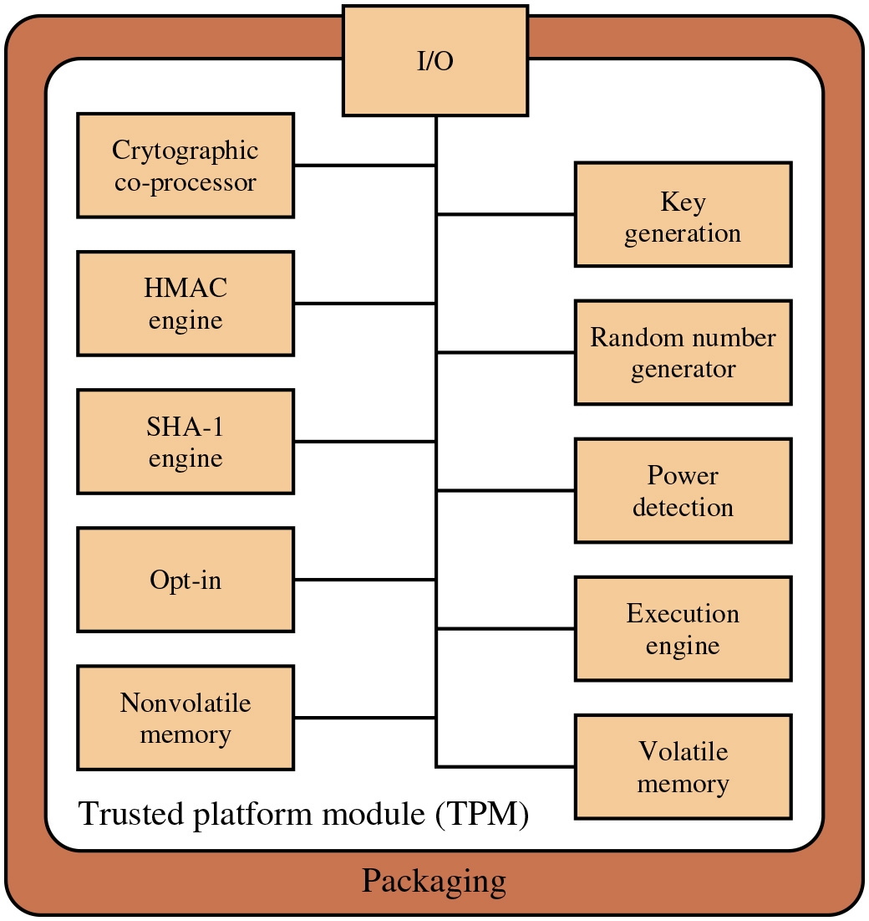
Figure 12.4
T P M Component Architecture
Notes:
Figure 12.4, based on the most recent T P M specification, is a block diagram of the functional components of the T P M. These are as follows:
• I/O: All commands enter and exit through the I/O component, which provides communication with the other T P M components.
• Cryptographic coprocessor: Includes a processor that is specialized for encryption and related processing. The specific cryptographic algorithms implemented by this component include R S A encryption/decryption, R S A-based digital signatures, and symmetric encryption.
• Key generation: Creates R S A public/private key pairs and symmetric keys.
• H M A C engine: This algorithm is used in various authentication protocols.
• Random number generator (R N G): This component produces random numbers used in a variety of cryptographic algorithms, including key generation, random values in digital signatures, and nonces. A nonce is a random number used once, as in a challenge protocol. The R N G uses a hardware source of randomness (manufacturer specific) and does not rely on a software algorithm that produces pseudo random numbers.
• S H A-1 engine: This component implements the S H A algorithm, which is used in digital signatures and the H M A C algorithm.
• Power detection: Manages the T P M power states in conjunction with the platform power states.
• Opt-in: Provides secure mechanisms to allow the T P M to be enabled or disabled at the customer/user’s discretion.
• Execution engine: Runs program code to execute the T P M commands received from the I/O port.
• Nonvolatile memory: Used to store persistent identity and state parameters for this T P M.
• Volatile memory: Temporary storage for execution functions, plus storage of volatile parameters, such as current T P M state, cryptographic keys, and session information.
Long Description:
The diagram is enclosed in a box labeled Packaging. The trusted platform module, or T P M, includes the I O placed at the top of the box. This I O branches into boxes below it, with five boxes on the left, and five boxes on the right. The boxes are placed below with an alternating position on the left and right from top to bottom in the following order: Cryptographic co-processor, key generation, H M A C engine, random number generator, S H A 1 engine, power detection, opt in, execution engine, non-volatile memory, and volatile memory.

Slide 64
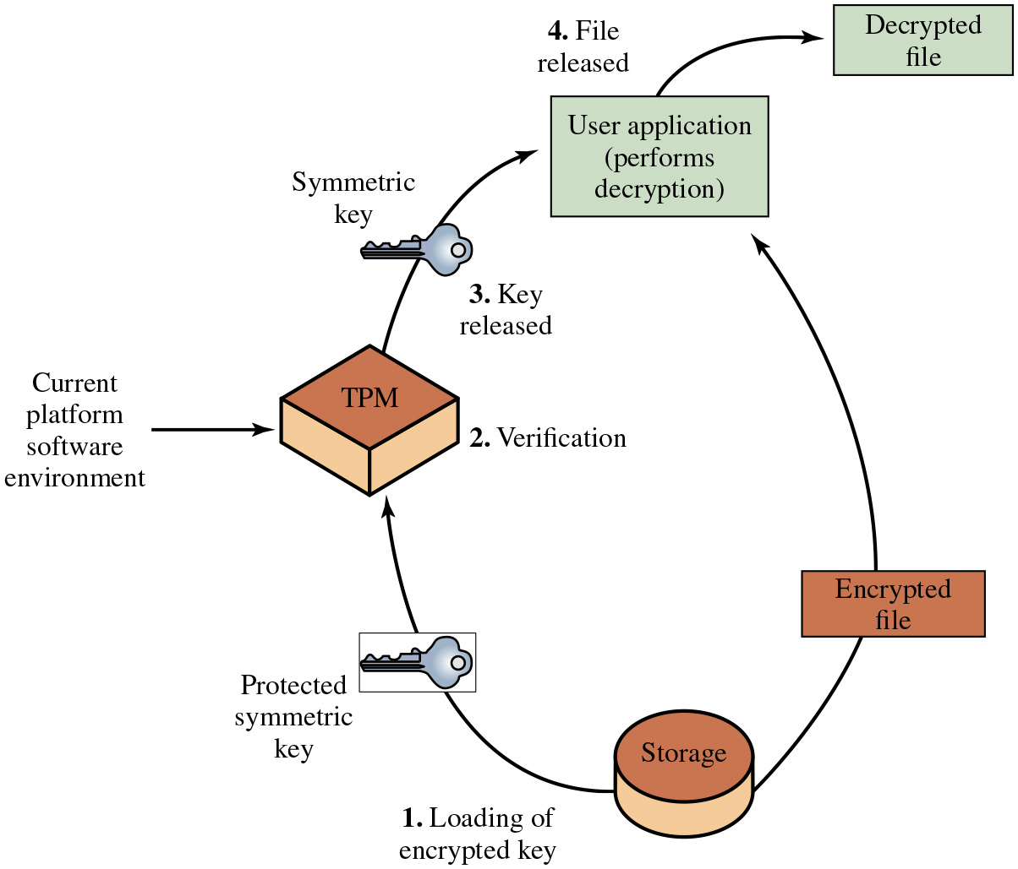
Figure 12.5
Decrypting a File Using a Protected Key
Notes:
To give some feeling for the operation of a T C/T P M system, we look at the protected storage function. The T P M generates and stores a number of encryption keys in a trust hierarchy. At the root of the hierarchy is a storage root key generated by the T P M and accessible only for the T P M’s use. From this key, other keys can be generated and protected by encryption with keys closer to the root of the hierarchy. An important feature of Trusted Platforms is that a T P M protected object can be “sealed” to a particular software state in a platform. When the TPM protected object is created, the creator indicates the software state that must exist if the secret is to be revealed. When a T P M unwraps the T P M protected object (within the T P M and hidden from view), the T P M checks that the current software state matches the
indicated software state. If they match, the T P M permits access to the secret. If they do not match, the T P M denies access to the secret.
Long Description:
Steps 1 to 4 are placed in a circle and passes through a counter clockwise direction.
Step 1: Loading of encrypted key. The protected symmetric key is loaded from storage into the T P M with input from the current platform software environment.
Step 2: Verification. The T P M verifies the key.
Step 3: Key released. The T P M releases the symmetric key to the user application, which performs decryption on an encrypted file received from storage.
Step 4: File released. The user application releases the decrypted file.

Slide 65

Recent Issue
Virtualized Environment Neglected Operations Manipulation
legacy virtual floppy disk controller - if sent specially crafted code, can crash the hypervisor, allowing hacker to break out of their own virtual machine to access other machines
Xen, KVM, and Oracle's VirtualBox affected; unnoticed for more than a decade
Don’t neglect testing of old s/w & h/w support routines if continuing to support them
Don’t support anything that you don't really need to (reduce attack surface)
Disable any facilities that you don't use
SJW
Notes:
The hypervisor should be secured using a process similar
to that with securing an operating system. That is, it should be installed in an isolated
environment, from known clean media, and updated to the latest patch level in
order to minimize the number of vulnerabilities that may be present. It should
then be configured so that it is updated automatically, any unused services are
disabled or removed, unused hardware is disconnected, appropriate introspection
capabilities are used with the guest OSs, and the hypervisor is monitored for any
signs of compromise.
Access to the hypervisor should be limited to authorized administrators
only, since these users would be capable of accessing and monitoring activity in
any of the guest OSs. The hypervisor may support both local and remote administration.
This must be configured appropriately, with suitable authentication and
encryption mechanisms used, particularly when using remote administration.
Remote administration access should also be considered and secured in the design
of any network firewall and IDS capability in use. Ideally such administration traffic
should use a separate network, with very limited, if any, access provided from
outside the organization.

Slide 66

Linux Pen Testing Distributions
Kali Linux (used in labs)
BackTrak Linux
Hacking Tools
SJW

Slide 67
Summary (1 of 4)
Introduction to operating system security
System security planning
Operating systems hardening
Operating system installation: initial setup and patching
Remove unnecessary services, applications and protocols
Configure users, groups, and authentications
Configure resource controls
Install additional security controls
Test the system security
Application security
Application configuration
Encryption technology
Notes:
Chapter 12 summary.

Slide 68
Summary (2 of 4)
Security maintenance
Logging
Data backup and archive
Linux/Unix security
Patch management
Application and service configuration
Users, groups, and permissions
Remote access controls
Logging and log rotation
Application security using a chroot jail
Security testing

Slide 69
Summary (3 of 4)
Windows security
Patch management
Users administration and access controls
Application and service configuration
Other security controls
Security testing
Virtualization security
Virtualization alternatives
Virtualization security issues
Securing virtualization systems
Virtualized infrastructure security
Virtual firewall

Slide 70
Summary (4 of 4)
Trusted computer systems
Reference monitors
T C S E C and common criteria
Trusted platform module
Authenticated boot service
Certification service
Encryption service
T P M functions
Protected storage

Slide 71

Copyright
This work is protected by United States copyright laws and is provided solely for the use of instructors in teaching their courses and assessing student learning. Dissemination or sale of any part of this work (including on the World Wide Web) will destroy the integrity of the work and is not permitted. The work and materials from it should never be made available to students except by instructors using the accompanying text in their classes. All recipients of this work are expected to abide by these restrictions and to honor the intended pedagogical purposes and the needs of other instructors who rely on these materials.

